Slide 1
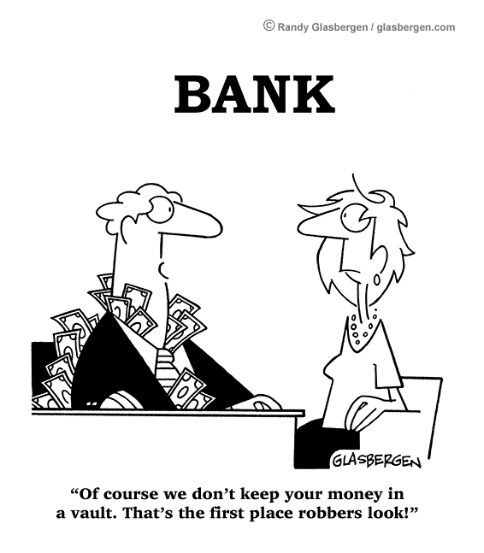
Financial Institutions
Notes:
Course outline
Effective effort handout

Slide 2
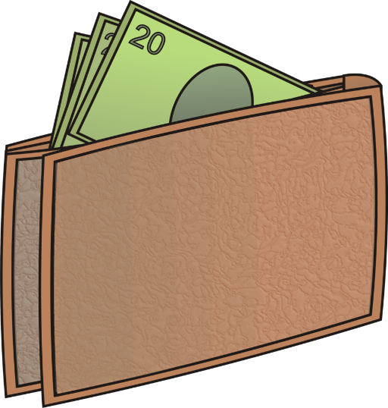
Banking & You
Money & You
Where do you put the money that you have to keep it safe? Do you keep it in a wallet or hide it somewhere in your house?
Do you have your own bank account?
Do you prefer to carry cash or use a debit card?

Slide 3
Banking & You
Different Types of Financial Institutions
There are actually many different types of financial institutions offering various services and knowing the differences between each will help you to make a more informed choice on where you would like to put your money and who you would like to manage it.
Banks
Credit Unions
Brokerage Firms
Wealth Management/Trust Companies
Required Reading: Different Types of Financial Institutions

Slide 4
Banking & You
How Safe is Your Money?
We are lucky in Canada because we have a very stable financial system. One of the reasons for this is because the Bank of Canada oversees the operation of financial institutions and there are many regulations and laws in place to protect the system.
 | Banks | Credit Unions
How are they regulated? | Canada’s banks are federally regulated according to the Bank Act. | Credit unions and Caisse populaires are regulated provincially under the FIRB or Financial Institutions Regulation Branch.
How much money is insured? | The CDIC (Canada Deposit Insurance Corporation) ensures most Canadian deposits at a bank for up to a maximum of $100,000 per depositor in each institution. This means that if the financial institution you have your money at goes out of business, you are automatically insured for this amount. | If you are a member of a credit union or a caisse populaire in Manitoba, your money is fully insured under the Deposit Guarantee Corporation of Manitoba. That means that ALL of your deposits are fully insured; there is no maximum limit.

Slide 5
Financial Institutions and You
Assignment #1

Slide 6
Banking & You
Chequing Accounts
A chequing account is a deposit account used for day-to-day spending
It is called a chequing account because before debit cards came along, writing cheques was the primary way individuals paid for items when they weren’t using cash
You can deposit and withdraw money from a chequing account and if you wish, your chequing account can be connected to a debit card or cheques
Some banks and credit unions also pay a low interest rate on the balance in your chequing account
Chequing accounts are designed to be used for day-to-day transactions and if you use this account for your spending (purchases, bills) then it will be easier to track your money flow.

Slide 7
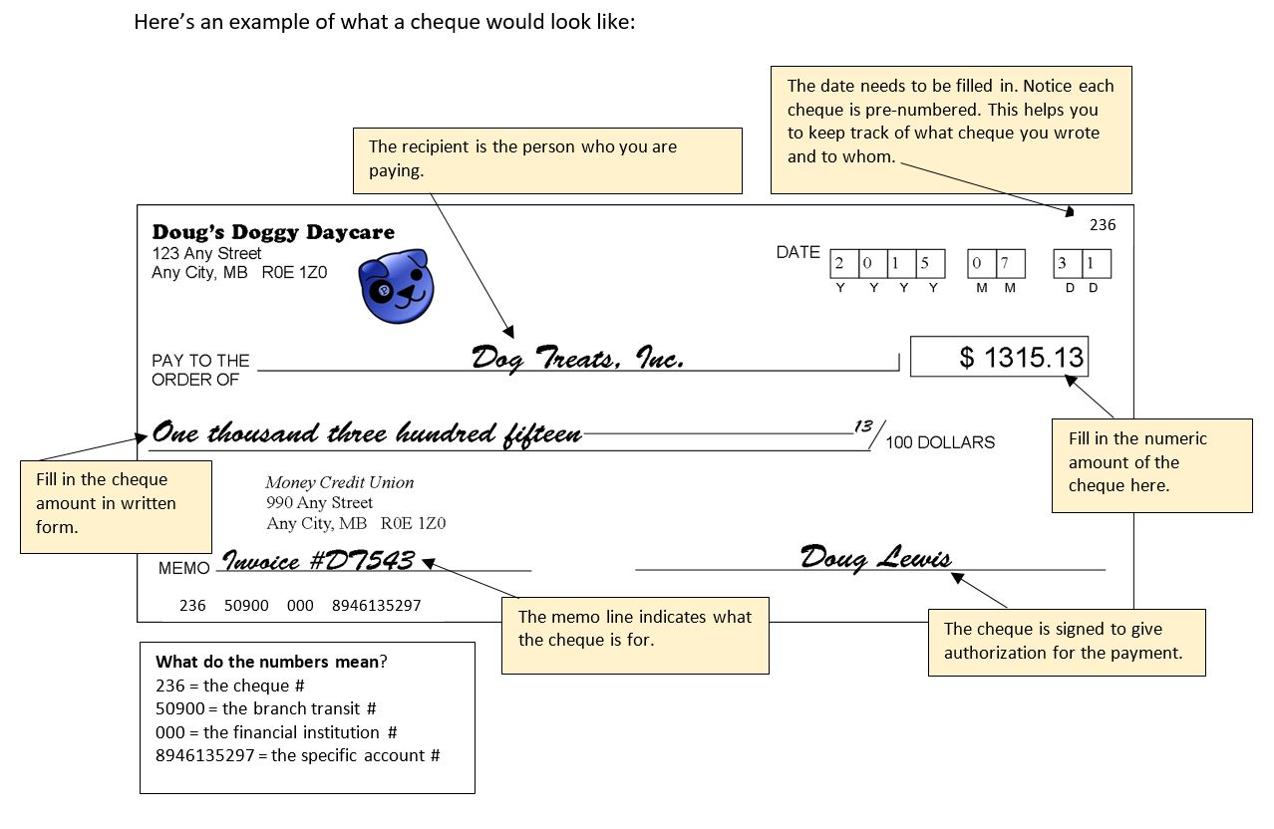

Slide 8
Step 1: Identify Your Banking Habits | Step 2: Shop Around | Step 3: Make the Final Decision
Consider how often you bank (add up the number of transactions you typically do in a month and make sure that’s included in your banking package) Consider where you bank (do you prefer to use an ATM, bank online, over the phone or in-branch? Make sure your preference is available at the bank or credit union you are considering) Think about what features you need (search for a chequing account that offers any additional features you might need such as personalized cheques, overdraft protection, safety deposit boxes, online spending trackers, etc.) | Think about the services you need and look for a bank or credit union that can meet these needs. You can use the FCAC Account Comparison tool to find the account that best suits your needs FCAC Account Comparison Tool | Make sure you understand what is included in the account and how much you’ll pay (be sure to ask about: monthly fees, the number and types of transactions included, extra fees that may be charged for certain transactions or if you go over your limit, discounts on fees, discounts if you are a youth or student, extra fees if you use another financial institution’s ATM, etc.) Make a choice based on the services that are important to you including: cost, customer service, ease of use
For more information, please visit: https://www.canada.ca/en/financial-consumer-agency/services/banking/bank-accounts/chequing-accounts.html

Slide 9
Banking & You
Savings Accounts
A savings account is a deposit account used for saving for unexpected expenses (sometimes called emergencies) or larger purchases in the future
Savings accounts allow for deposits and withdrawals as well; however, ideally you are making more deposits than withdrawals or you won’t save much!
Banks and credit unions generally pay a modest interest rate on the balance of your savings account and may even offer a variety of savings accounts that offer higher interest rates if you meet certain criteria.

Slide 10
Savings Account Considerations
The FCAC (Financial Consumer Agency of Canada) suggests that you consider the following items when shopping for a savings account:
Minimum Deposit (Some accounts may require you to keep a minimum amount in your savings account in order to get the interest advertised.)
Interest Rates (The higher the interest rate, the more money you’ll earn. Sometimes financial institutions offer high-interest introductory rates that only run for a specific period of time. Make sure you understand the interest rate that is offered.)
Service Fees (You don’t usually pay monthly fees to have a savings account; however, you may still pay fees for withdrawals or transfers and you may have limited transactions. Make sure you read your account agreement carefully.)
Accessing the Money in your Savings Account (If you need to access your savings account can you do so through a nearby automated teller machine (ATM) and/or can you manage your account online?)
How your Financial Institution Calculates Interest (Make sure you understand the terms of your account agreement to find out how your financial institution will apply interest. Some financial institutions apply two or more different interest rates to your balance.)*You will learn more about interest in Unit 6.

Slide 11
Chequing and savings accounts serve different purposes; if you pay for all of your purchases and bills using your chequing account, you can keep better track of what you are spending as well as your balance. Savings accounts should be used primarily for deposits so that you can continue to save; you should only withdraw money in an emergency or when you are ready to use the money for the purpose you had saved for. In fact, some individuals choose to open multiple savings accounts for specific purposes.
University
College
Travel
Car
Moving Out
Clothes
Think About:
What are some things you want to save up for?

Slide 12
Financial Institutions and You
Assignment #2
Banking Terms Activity
Making Your Chequebook

Slide 13
Banking & You
The FRC Bank™
Use the FCAC Account Comparison Tool to find a savings account package that you would like: we will double the interest rate! (1) Just print the package information, sign and submit to get your account started. (2) Now make your chequebook.
Everyone will get $1,000 in their bank account to start. You can add more cash by depositing your FRCBucks™ at the FRC Bank.

Slide 14
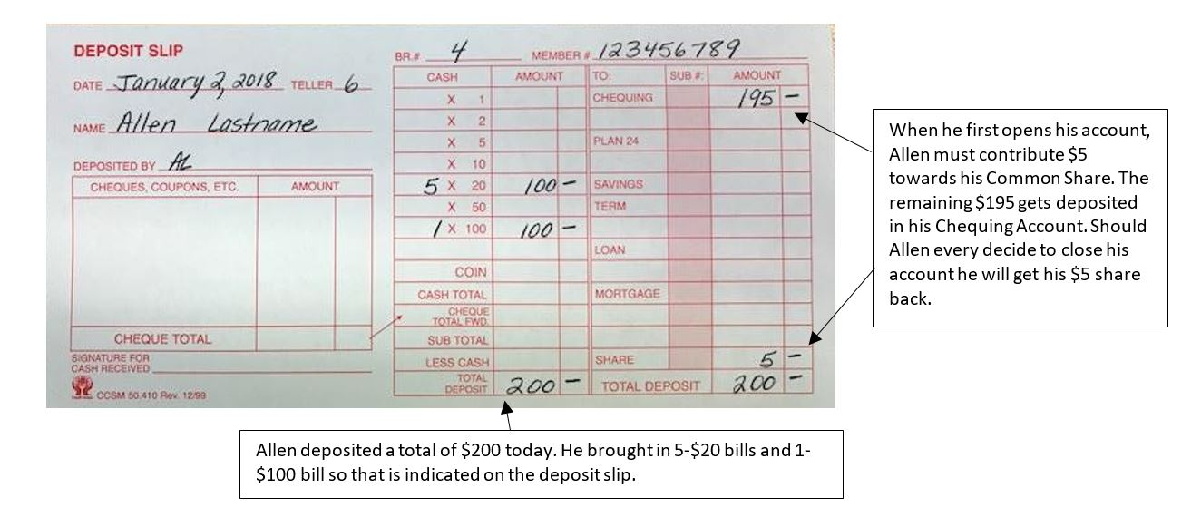
Banking & You
Allen Gets a Bank Account
Allen opens a chequing account at the Centurion Credit Union with an initial deposit of $200.

Slide 15
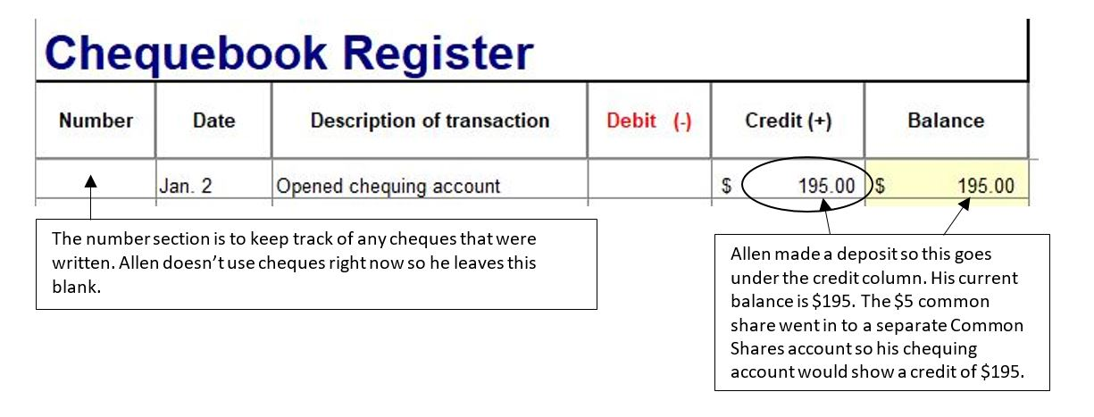
It is important to keep track of your financial transactions so you can monitor your spending and cash flow; this will allow you to have a good idea of your account balance at all times. It will also give you a record to compare to your bank or credit union statements.
A Chequebook Register (also called a Transaction Register) can be used to keep track of all of the money that goes in (credits) an out (debits) of your account.

Slide 16
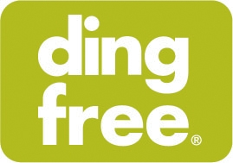
Banking & You
Allen Gets a Debit Card
Allen would like to use his debit card to access his credit union ATM after hours as well as to pay for purchases when he doesn’t have cash. Having a debit card is a big responsibility and it is important to protect your card and your PIN (personal identification number). The member service representative at the credit union walks Allen through the process of creating his own personal PIN and shows him how to use his ATM debit card at the ATM in the branch.
Your Money Credit Union
Member Card
12345678901234567890
Most credit unions are a part of the “ding free” system and the downloadable app helps you find credit unions in your area.

Slide 17
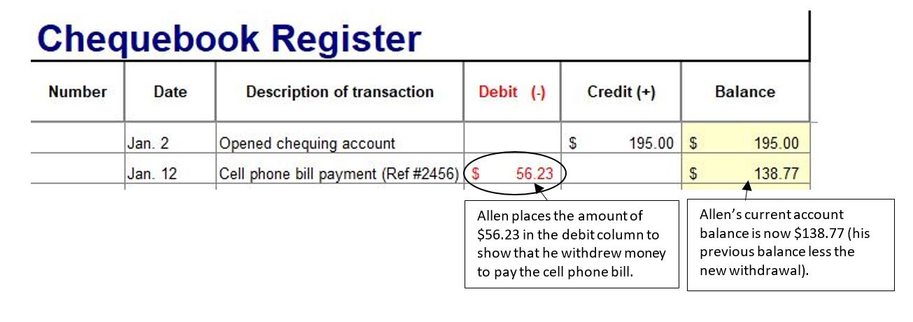
Banking & You
Allen Accesses Online Banking
Allen received a cell phone bill for $56.23 so he sets that up to be paid online. Once the payment is processed the money is automatically taken out of Allen’s chequing account.

Slide 18
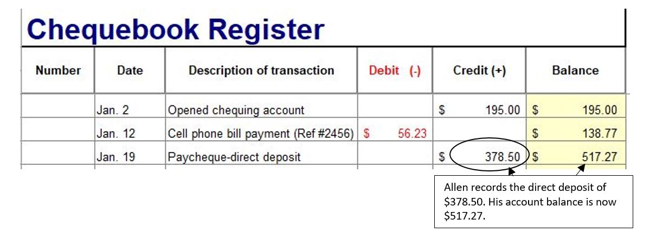
Banking & You
Allen Uses Direct Deposit
Allen has a part-time job and instead of issuing physical paycheques, his employer prefers to do direct deposit. This means that when it is payday, Allen’s pay will be automatically deposited into his account.

Slide 19
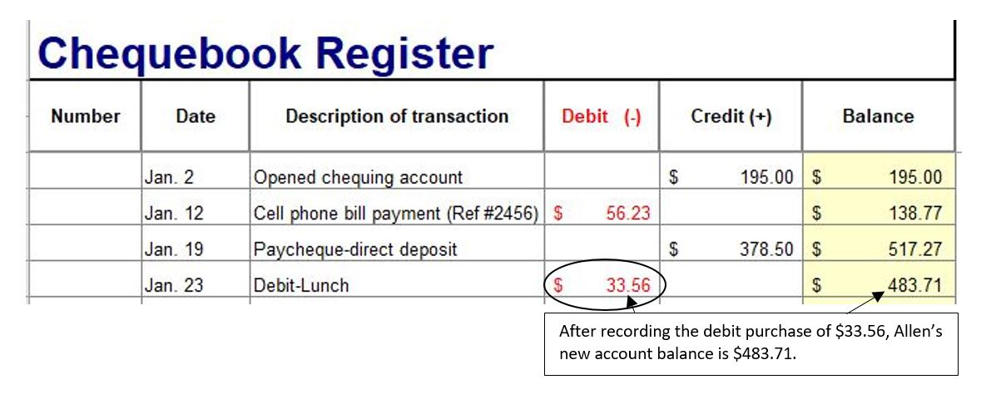
Banking & You
Allen Makes a Withdrawal
Allen decides to take his friend out for lunch on his birthday and he pays for the bill (which totaled $33.56) using his debit card. When you use a debit card the money is automatically withdrawn from your bank account.

Slide 20
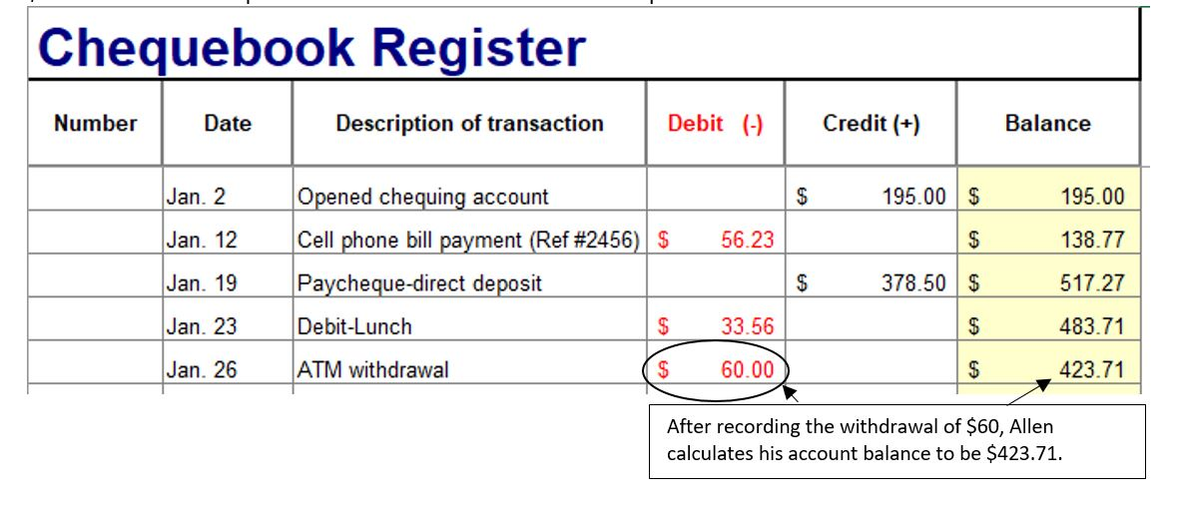
Banking & You
Allen Uses an ATM
Later that week, Allen decides that he need to have some actual cash for a few events coming up at school where only cash is accepted. Allen goes to his local credit union and uses the ATM to withdraw $60.

Slide 21
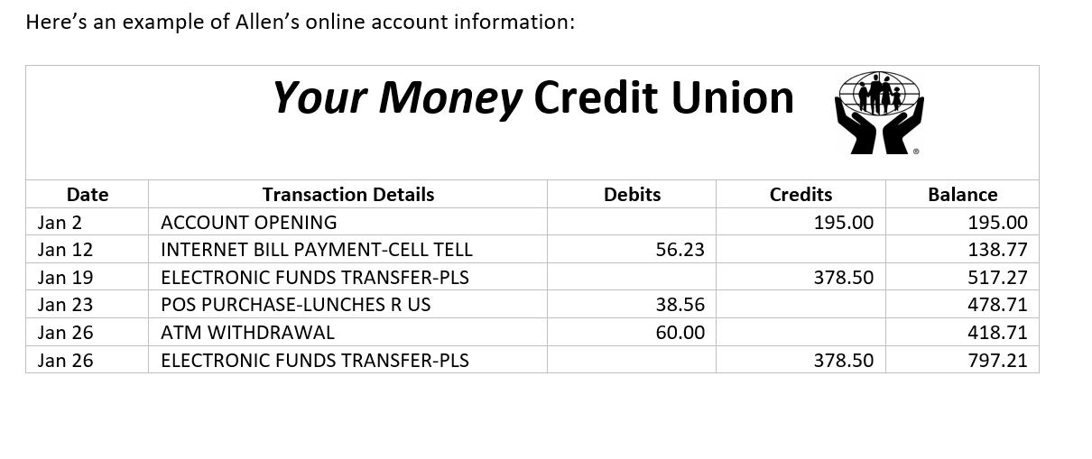
Banking & You
Checking Your Records
Every so often it is a good idea to check your records against the records of your bank or credit union. If you have access to online banking you can check your debits (withdrawals), credits (deposits) and account balance at any time.

Slide 22
Banking & You
Account Reconciliation
It is a good idea to compare your records with your bank or credit union to see if there are any discrepancies (differences).
For example, Allen accesses his online banking and notices that his account balance according to his credit union is $797.21; however, according to his Chequebook Register his account balance is only $423.71.
What might have happened?

Slide 23
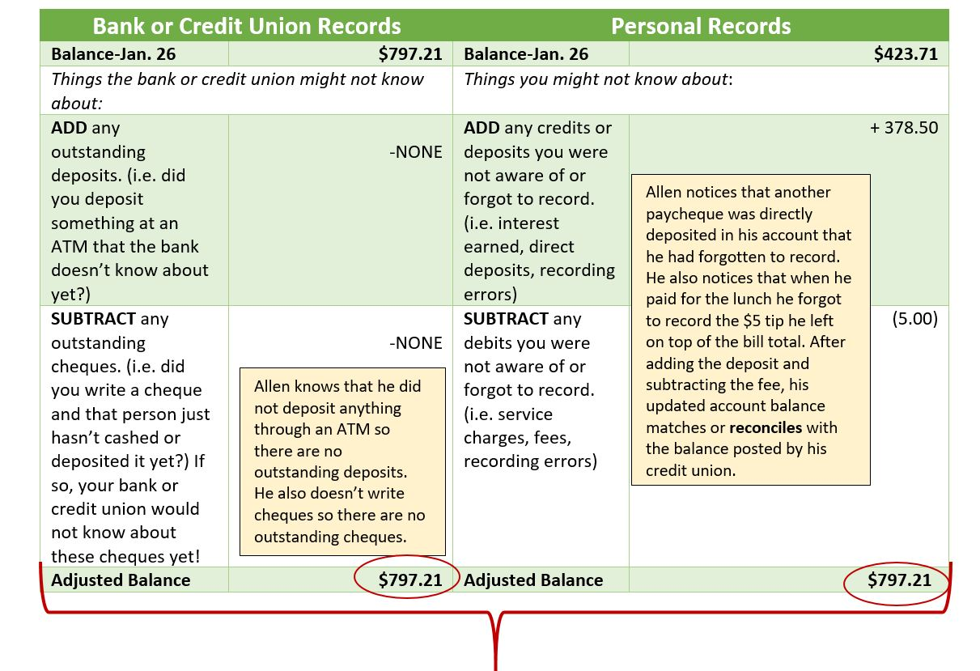
Allen can fill out a simple form like this to find the discrepancies:

Slide 24
Banking & You
Updating Your Register
If you do find discrepancies, it is always important to update your chequebook register with the changes. When Allen makes the adjustments his account balance reconciles with the online records published by his credit union.

Slide 25
Financial Institutions and You
Assignment #3

