Slide 1
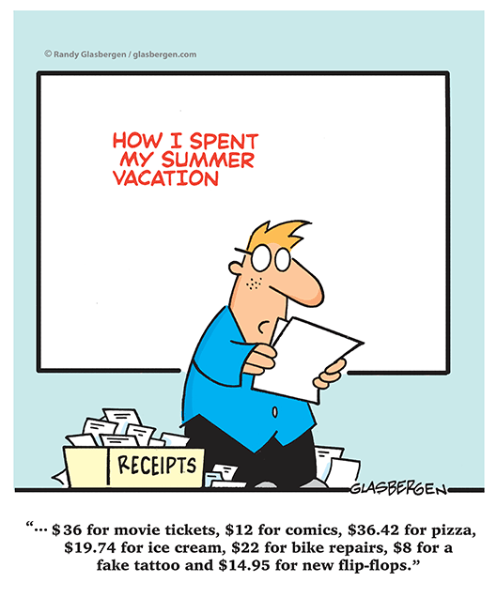
The Flow of Money
Notes:
Course outline
Effective effort handout

Slide 2
Banking & You
Earning Money
By now you’ve probably figured out that it would be difficult to do the activities associated with personal finance like spending, saving, gifting and investing if you don’t have any money so we are going to start by looking at the concept of earning first.
Another word that is often used instead of earning is income; this lesson will focus on the money flowing IN to your wallet or bank account.

Slide 3
Banking & You
Remuner-what?
Remuneration
When we attain employment, we are agreeing to provide labour or services in exchange for money. There are many ways that individuals can be paid or remunerated for the work that they do.
Every job and employer may be different, so it is always important to understand how you will be paid for the work that you do before you accept employment.

Slide 4
Banking & You
Wage
A wage is a payment of money for labour or services based on an hourly, daily or weekly basis.
In Canada, every province has a minimum wage standard. Minimum wage is the lowest amount, per hour, that employees must be paid for their work. The current minimum wage in Manitoba is $11.15 per hour. This is regulated by our provincial government under the Employment Standards Act and is designed to protect employees and set a minimum standard for how much they get paid for the work they do.

Slide 5
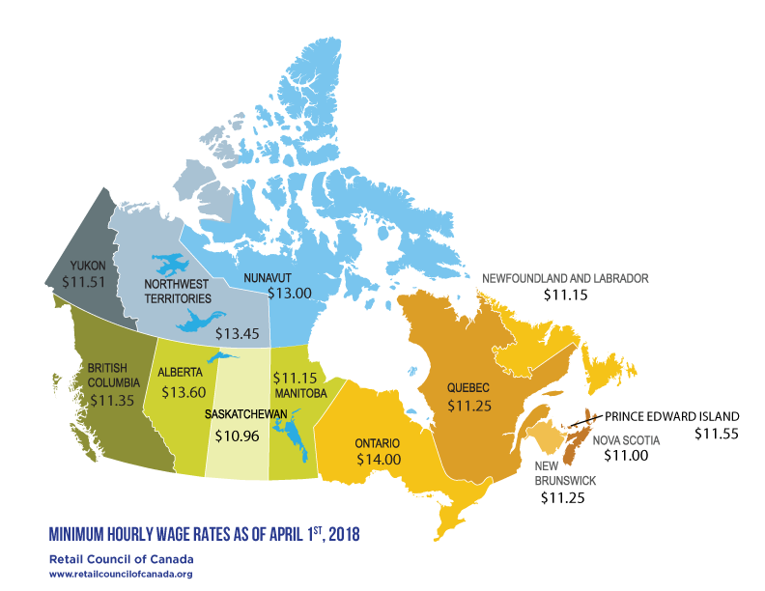

Slide 6
Banking & You
Overtime Pay
It is also possible in some jobs for employees to earn overtime pay. This is when an employee works longer than the standard 8-hour day or 40 hours a week. If the employee works longer they must be paid 1 ½ times their regular wage for the hours that are overtime.

Slide 7
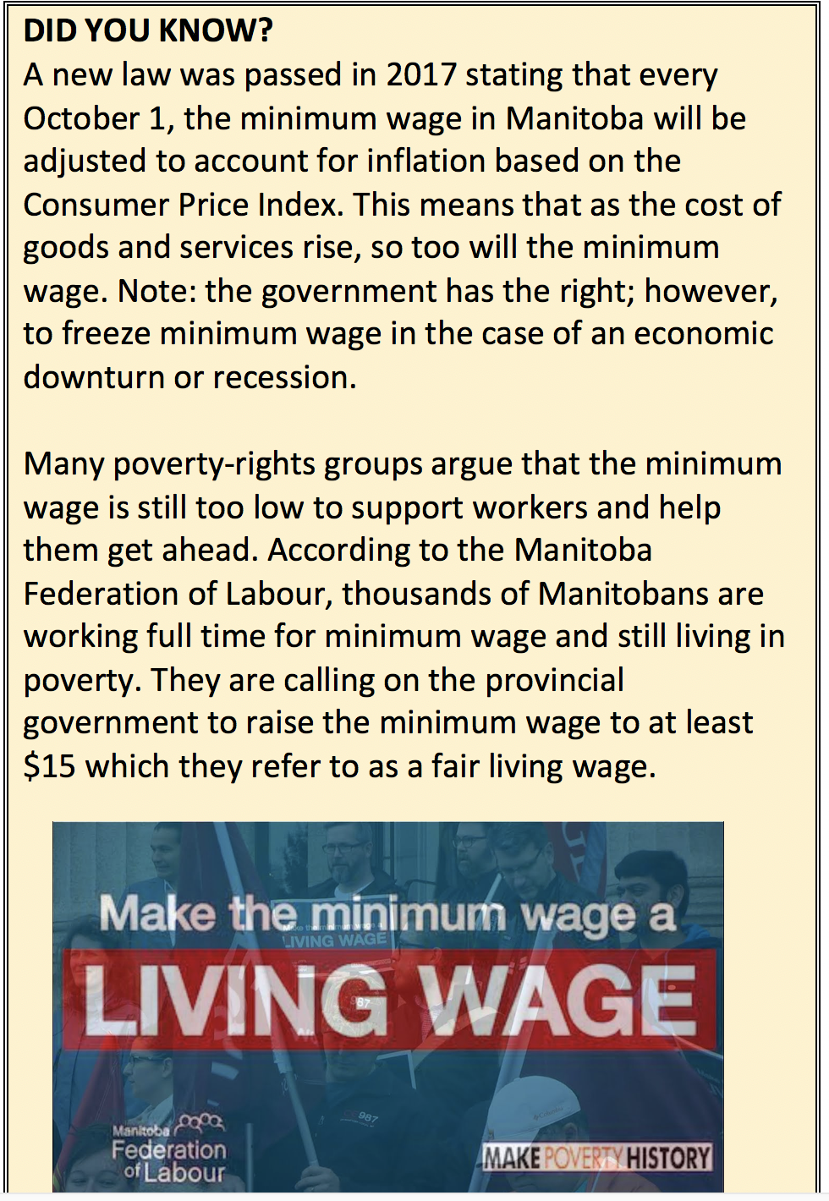
What are the Pros and Cons of raising the minimum wage to $15.00?

Slide 8
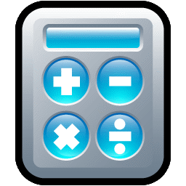
Let’s Do The Math!
Harleen works 40 hours a week at her job where she is paid minimum wage at a rate of $11.15 per hour. How much will Harleen earn in one week?
Jon works 52 hours this week at his job where he receives an hourly rate of $15.00 per hour. How much will Jon earn this week? (Hint: He is eligible for overtime pay for the hours over the standard work week).

Slide 9
Banking & You
Salary
A salary is a payment of money for labour or services usually paid out monthly, or bi-weekly (every two weeks). A salary is usually expressed as an annual sum of money that is then separated into equal payments throughout the year.

Slide 10
Let’s Do The Math!
Jon’s salary at his job is $54,000 per year. If he gets paid monthly, how much will he earn each month?
Now let’s assume Jon gets paid bi-weekly instead of monthly. How much will he earn every two weeks? (Hint: There are typically 26 pay periods in a bi-weekly pay calendar.)

Slide 11
Banking & You
Commission
A commission is a payment of money for selling a certain amount of goods and services. The two most common types of commissions include: “percentage of sales” and “flat rate based on sales volume”. Some employees earn just the commissions they make; however, if their total earnings do not equate to at least minimum wage, the employer would be required by law to top up their pay. Some employers may also choose to pay their employees a wage or base salary plus the commission they earn.

Slide 12
Let’s Do The Math!
Janvit earns a 5% commission on his total sales each week. This week, his total sales were $12,000. A) Assuming Janvit does not get a wage or base salary, how much will he make this week? B) Would his employer need to top up his pay to make sure he made the minimum wage standard?
Hannah earns a base salary of $2,000 a month plus $250 for every 1000 units of a product she sells. If Hannah sells 3000 units of a product, how much would she make this month?

Slide 13
Banking & You
Contract Work
Contract work is when an individual is hired to do a specific task for a specific rate of pay. A contract is a spoken or written agreement between individuals or organizations that should clearly outline the key terms of the contract such as: the specific task or job description, start and end date, and of course, the payment terms. Independent contractors may not fall under the Employment Standards Act so it is important that you carefully negotiate and consider any contract work you may be offered before you agree to the terms.

Slide 14
Let’s Do The Math!
Olive works as a commercial cleaner and she has several businesses with whom she has a contract with to clean their office space in the evening. Company A pays Olive $500 per week; Company B pays Olive $800 per week and Company C pays Olive $1,200 per week. Assuming these are her only clients, how much will Olive make this week in contract work?

Slide 15
Banking & You
Piece Work
Piece work is where employees are paid a fixed rate for every unit or item they produce or action they perform. Like commissions, they are designed to provide incentive for employees to increase their productivity and in return earn more money. Some employees earn just the piece work pay they make; however, if their total earnings do not equate to at least minimum wage, the employer would be required by law to top up their pay. Other employers pay their employees a wage or base salary plus the piece work rate they earn.

Slide 16
Let’s Do The Math!
Janet works at a factory that manufactures clothing. She is paid $0.50 for every zipper she sews on a dress.
A) If Janet sews 35 zippers an hour, how much would she make per hour?
B) If Janet works an 8-hour shift and she consistently sews 35 zippers an hour, how much would she earn in a day?
Nick works at a strawberry farm and he makes a wage of $11.15 an hour. In addition to that, for every basket of strawberries he picks, he earns an additional $2.00. If Nick works a 5-hour shift and picks 9 baskets of strawberries, how much would he earn in a day?

Slide 17
The Flow of Money
Assignment #1

