Slide 1
Budget Basics
Module 4 Lesson 3

Slide 2
Lesson Focus
By the end of this lesson, you should be able to:
Explain the difference between needs and wants
Identify the difference between fixed and variable expenses
Prepare and analyze a budget

Slide 3
Needs vs Wants
Needs: items that are considered essential to sustain life and include items such as food, water, shelter, clothing and relationships
Wants: items we would like to have but are not necessary to sustain life
It can sometimes be difficult to distinguish between needs and wants because the business world does a great job of marketing their products and services to convince us that we need things
For example, we need water to sustain life, but we don’t need mochas or lattes every morning
We need shelter or housing but we don’t need to live in a large house
We need clothing, but we don’t need expensive designer brands

Slide 4
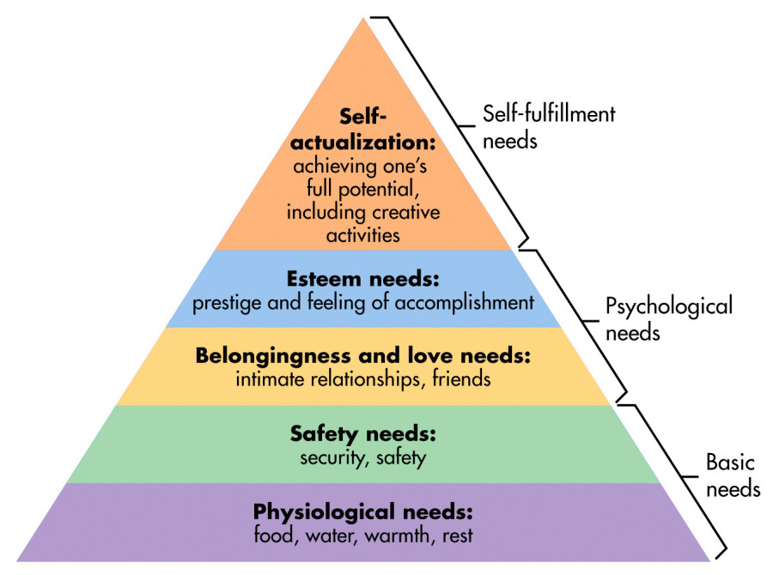
Maslow’s Hierarchy of Needs
https://www.simplypsychology.org/maslow.html

Slide 5
Maslow
The higher need levels can be more complex because business marketing, pop culture and media play a role in convincing us that we can get approval, love or a high status if we have certain things
This is why sometimes the line between needs and wants can get blurry
If you were asked to make a list of all of the things you need and want you list would likely be very long
This is where financial decision making comes into play; you can’t possibly buy everything you need and want so you will have to make spending decisions based on your income, your financial goals and what is right for you
A budget will help you do that

Slide 6
Think About
Do you spend more of your money on needs or on wants?
Now think about your parents or guardians…do they spend more of their money on needs or on wants?
If your response is different for the two questions above, why might this be?

Slide 7
Fixed vs Variable Expenses
Fixed expense: money that is spent on items that must be paid every month
Generally, the amounts of these fixed expenses remain the same from month to month because they are part of a contract or payment plan
E.g. rent or mortgage payments, car payments insurance payments, cell phone bills and utility bills such as electricity and water
Often fixed expenses are most associated with needs
There isn’t a lot of flexibility in the spending on fixed expenses unless you decide to cut one of these expenses or renegotiate the price of the expense item

Slide 8
Fixed vs Variable Expenses
Variable expense: money that is spent on items where the amount changes or varies from month to month
E.g. eating out, entertainment, extra clothing, hair care, gifts and vacations
Often variable expenses are most associated with wants
There is more flexibility in the spending on variable expenses because you have more personal control over the month to month decisions you make on the spending in this area

Slide 9
Did You Know?
Teens can be a very profitable segment for marketers because they have more discretionary income (as a percentage of their total income) compared to most adults
Discretionary income: the amount of money you have left over after all of your fixed expenses have been paid for
Teens who work generally have higher discretionary income percentages because they don’t have a lot of fixed expenses that they are required to pay for themselves
For example, if they are still living at home with parents or guardians their basic needs in life like shelter, food, clothing and transportation are met so they spend their money more on wants
This is why goal setting and financial planning is important to think about early
Once you start making money, how will you balance spending and saving
Learning how to budget is a good start

Slide 10
What is a Budget?
Budget: a document that helps you to control your cash flow and manage your personal finances
If done correctly, a budget can help you:
Plan how you will allocate your money as well as
Track how well you are sticking to that plan

Slide 11
Before You Start
Think About Your Goals
What are your personal financial goals?
Are you saving to further your studies?
Do you want to buy a home, travel or begin saving for retirement?
Do you have any debts to pay off?
Keep Track of Your Money Flow
Most people are aware of their income (money coming in) but don’t always know how much they are spending (money going out)
If you keep good track of your money you will be able to track whether you are sticking to your budget

Slide 12
A Basic Budget
Demo page 52

Slide 13
Emergency Fund
Unexpected life events that you’re not able to predict on your budget so an emergency fund leaves a built in “cushion” to account for this
Examples of emergency events could include:
An unexpected change in income
What if you get sick and can't work for a few days
What is you get laid off
Unexpected expenses
What is you need to go somewhere that may require calling a taxi or ride-sharing service?
What is you need to spend extra money on medication or at a dental visit?
What if you get invited to a special party, wedding or event and have to spend on clothing and on tickets or gifts?
Emergency funds allow you to plan for those unexpected events so that you don’t have to borrow money or go into credit card debt to cover them

Slide 14
The “Pay Yourself First” Principle
Dario plans to continue his studies next in college so he is saving up for this
His current plan involves saving at least 15% of his net income and has this money automatically withdrawn from his chequing account into his savings account each month
This is called the “pay yourself first” principle because you are building your savings right into your budget rather than just saving whatever is left over tat the end
The benefit of following the “pay yourself first” principle is that you ensure saving is part of your financial plan rather than just an afterthought

Slide 15
Working the Budget
Developing a budget allows you to plan how you will allocate your money and achieve your financial goals
It is important to be realistic with the income and expenses you record on your budget so that you will be able to stick with your plan
It is also important to stick to your budget as much as as possible in order to achieve your financial goals
Compare what is actually spent so that you can see how well you stick to your plan and make any necessary adjustments

Slide 16
Working the Budget
Use the chequebook register where all transactions are recorded to calculate what is actually earned and spent on each line of the budget
Calculate the difference by subtracting the actual amounts from the budget amounts
Demo page 54

Slide 17
Budget Adjustments
Options to avoid running a deficit
Cut back on variable expense
Cut back on fixed expense
Increase income

Slide 18
Remember
If you are clear on your personal and financial goals you will make better decisions how how to allocate your money
Identify your Goals
Gather Information on the Alternatives
Consider your Options
Make a Decision /Take Action
Evaluate your Decision

Slide 19
Poverty Cycle
Many individuals who work for low wages struggle to budget and make ends meet because they just don’t earn enough to cover the basic cost of living in Manitoba
When you live “paycheque to paycheque” a poverty cycle is created because it is almost impossible to save and get ahead because you need to allocate all of your money just to take care of your basic needs
This can be extremely stressful for individuals, families and society as a whole
Many poverty-rights groups are arguing for a living wage that would be closer to $15/hour instead of our current minimum wage
The United Way estimates that 1 in 10 Winnipeggers live in poverty
Online poverty simulation
http://makethemonth.ca/
Assignment #4

