Slide 1
Tax Time
Module 4 Lesson 2

Slide 2
Lesson Focus
Explain why Canadians pay taxes to various levels of government
Prepare a personal income tax return

Slide 3
Introduction
You learned that when you get paid for the work you do you don’t get to keep all of your earnings
Mandatory deductions EI, CPP (if you’re 18 and over), and Income Tax
This lesson looks at why Canadians have to pay taxes to the various levels of government and what some of this money is used for
You will also learn how to prepare a basic income tax return

Slide 4
Review
What are Taxes?
A required contribution of money to a particular level of government
We pay taxes on our income, property and most of the goods and services we buy
Federal, provincial, and municipal governments use the tax money they collect to provide public goods and services
Because we are talking about income tax in this lesson, we will focus on federal and provincial tax

Slide 5
What is Federal Tax Money Used For?
The federal government uses tax dollars to re-invest in our economy to help it to grow.
In 2017, the federal government had a fiscal policy focused on investing heavily in infrastructure, social housing, education and innovation.
Here are just a few examples of investments the federal government planned to make as outlined in the 2017 budget:
Investing $221 million to target 10,000 work-integrated placements for post-secondary students
Investing $396 million to expand employment opportunities for young Canadians
Investing $1 billion to make parental benefits more flexible and to create a new caregiving benefit and support training
Investing $20 billion for better public transit systems
Investing $7 billion for stronger, more efficient trade corridors
Investing $11 billion for a National Housing Strategy
Source: http://www.budget.gc.ca/2017/home-accueil-en.html

Slide 6
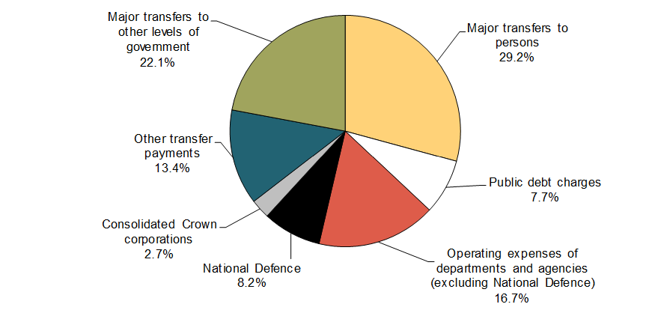
What is Federal Tax Money Used For?
The federal government uses tax dollars to provide public goods and services
http://www.tbs-sct.gc.ca/ems-sgd/edb-bdd/index-eng.html#partition/dept/exp
https://www.ctvnews.ca/politics/2016-2017-federal-budget-breakdown-1.2827888

Slide 7
Public Goods and Services
If the federal government did not collect taxes, they would not be able to fund the departments and programs that they do
https://www.canada.ca/en/services.html

Slide 8
What is Provincial Tax Money Used For?
Much like the federal government, each province also collects income tax in order to invest or spend it to grow the economy as well as to provide public goods and services
https://www.gov.mb.ca/government/departments.html

Slide 9
Filing Your Income Tax Return
Doing your taxes (which involves completing the required paperwork and submitting any amount you owe) is your responsibility as a Canadian citizen
When you fill in the tax forms required, you will be able to determine if you must remit (send in or submit) tax to the government or if you are owed a refund (return)
Even if you have no income, it is a good idea to do your taxes so that you can get the benefits and tax credits that apply to you

Slide 10
Key Points
Most Canadians must fill out their tax forms and submit them to the Canada Revenue Agency by April 30th each year
While you can still fill out your tax forms on paper, most Canadians choose to file online because it is faster (NETFILE is a free electronic filing service that lets you send your tax return directly to Canada Revenue Agency
Before you start filling out your tax return, it is important to collect all of the necessary documentation that shows your income, including your original T4 (Statement of Remuneration Paid)
Employers are required to give employees their T4s by the end of February each year
It is your responsibility to research what deductions, tax credits and expenses you can claim on your tax return (which reduces the amount of tax you owe)
You must keep all of your documents related to each tax return for at least six years in case Canada Revenue Agency asks to see them
If you are entitled to a refund you will receive your refund money anytime between eight days to eight weeks depending on how you filed your tax return
If you must remit taxes (meaning you owe money) there are a variety of ways you can pay Canada Revenue Agency including online banking transfers, debit card, credit card, pre-authorized debit, etc.
If you owe money, but cannot pay the full amount due, it is your responsibility to contact Canada Revenue Agency right away to set up a payment arrangement to avoid any interest or penalties
Source: https://www.canada.ca/en/services/taxes/income-tax/personal-income-tax/doing-your-taxes.html

Slide 11
Understanding Your T4 Slip
By the end of February each calendar year, your employer is required to give you a T4 slip so that you can do your taxes
The formal name for the T4 slip is the T4 Statement of Remuneration Paid
If you worked for more than one employer that year, you will receive multiple T4 Slips

Slide 12
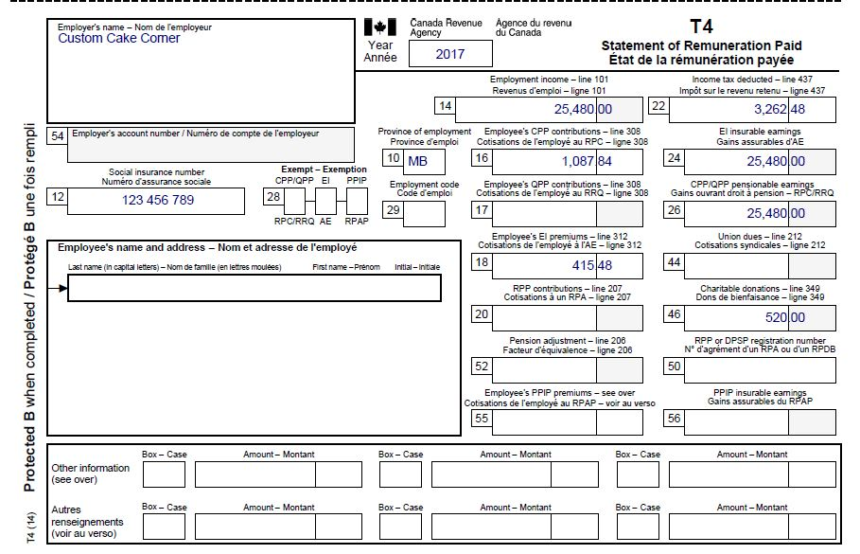
Example for Dario Duplo who worked at Custom Cake Corner in 2017
Box 14 is Dario’s employment income for the year from Custom Cake Corner (his employer).
Box 16 is the total amount of CPP deducted off his paycheques by this employer.
Box 18 is the total amount of EI deducted off his paycheques by this employer.
Box 22 is the total amount of income tax deducted off his paycheques by this employer (this includes federal and provincial tax).
Box 46 indicates the amount of charitable donations deducted off his paycheques through this employer.
DUPLO DARIO

Slide 13
Doing Your Taxes
Once you have your T4 slip(s), you can start completing your income tax return
Let’s go through an example…
https://www.canada.ca/en/revenue-agency/services/forms-publications/tax-packages-years/general-income-tax-benefit-package/5000-r.html

