Slide 2
Chapter 2 Demand and Supply
Old Joke: Teach a parrot to say demand and supply, and you’ve created an economist.
Intro Activity

Slide 3
Learning Objectives
After this chapter, you will be able to:
describe the nature of demand, changes in quantity demanded, changes in demand, and the factors that affect demand
summarize the nature of supply, changes in quantity supplied, changes in supply, and the factors that affect supply
explain how markets reach equilibrium – the point at which demand and supply meet

Slide 4
What Is Demand?
Demand: is a relationship between a product’s price and quantity demanded.
Quantity demanded: the amount of a product consumers are willing to purchase at each price
Demand is shown using a schedule: a table that shows possible combinations of prices and quantities demanded of a product or curve: a graph that expresses possible combinations of prices and quantities demanded of a product
The law of demand: states that price and quantity demanded are inversely related.
Market demand: is the sum of quantities demanded by all consumers in a market.
http://www.investopedia.com/video/play/law-demand/
Notes:
1

Slide 5
The Demand Curve FIGURE 2.1
Your Demand Curve for Strawberries
Your Demand Schedule
for Strawberries
2.50
a
2.00
b
Price
($ per kg)
Quantity Demanded
(kg per month)
Point
on graph
1.50
c
Price ($ per kg)
D
$2.50
7
a
1.00
2.00
9
b
0.50
1.50
11
c
0
1
3
5
7
9
11
13
Quantity Demanded
(kg per month)
Notes:
3

Slide 6
Deriving Market Demand FIGURE 2.2
Your Demand Curve for Strawberries
Friend’s Demand Curve for Strawberries
2.50
2.50
2.00
2.00
1.50
1.50
Price ($ per kg)
Price ($ per kg)
1.00
D₀
1.00
D₁
0.50
0.50
0
1
2
3
4
5
6
7
0
1
2
3
4
5
6
7
Quantity Demanded (kg per month)
Quantity Demanded (kg per month)
Market Demand Curve for Strawberries
Individual and Market Demand
Schedules for Strawberries
2.50
Price
($ per
kg)
You
(D₀)
Friend
(D₁)
Market
(D_{m})
2.00
1.50
Price ($ per kg)
(kg per month)
1.00
D_{m}
$2.50
2.00
1.50
1
2
3
2
3
4
3
5
7
0.50
0
1
2
3
4
5
6
7
Quantity Demanded (kg per month)
Notes:
3

Slide 7
Changes in Demand
Changes in demand:
are shown by shifts in the demand curve
are caused by changes in demand factors: factors that can cause an increase or a decrease in a product’s demand
Increase in demand: an increase in the quantity demanded of a product at all prices—curve shifts to the right
Decrease in demand: an decrease in the quantity demanded of a product at all prices—curve shifts to the left
Notes:
2

Slide 8
Changes in Demand FIGURE 2.3
Market Demand Curve for Strawberries
Market Demand Schedule
for Strawberries
2.50
Price
($ per kg)
Quantity Demanded
(millions of kg)
2.00
(D₂)
(D₀)
(D₁)
1.50
Price ($ per kg)
D₂
D₀
D₁
$2.50
5
7
9
1.00
2.00
7
9
11
0.50
1.50
9
11
13
0
1
3
5
7
9
11
13
Quantity Demanded
(millions of kg per year)
Notes:
3

Slide 9
Demand Factors (a)
Demand factors include the following:
The number of buyers (an increase causes a rightward demand shift).
Income
For normal products: products whose demand changes directly with income, an increase causes a rightward demand shift.
For inferior products: products whose demand changes inversely with income, an increase causes a leftward demand shift.
Notes:
4

Slide 10
Demand Factors (b)
Prices of other products
For substitute products: products that can be consumed in place of one another, a rise in the other product’s price causes a rightward demand shift.
For complementary products: products that are consumed together, a rise in the other product’s price causes a leftward demand shift.
Notes:
5

Slide 11
Demand Factors (c)
Consumer preferences: current trends or events that affect people’s preferences
Consumer expectations: about future prices and their own incomes affect their current purchases
http://reffonomics.com/Demand.html
http://www.grokkingecon.com/?ms=1442972569292
Notes:
5

Slide 12
Changes in Quantity Demanded
Changes in quantity demanded:
are shown by movements along demand curve
are caused by price changes
http://www.youtube.com/watch?v=Ng3XHPdexNM (hula hoop)
http://www.youtube.com/watch?v=aTSwcXJ700c (micro course)

Slide 13
Changes in Quantity Demanded (b) Figure 2.4, page 39
Changes in Quantity Demanded FIGURE 2.4
Change in Quantity Demanded
Change in Demand
2.00
a
2.00
1.50
b
1.50
Price ($ per pair of skis)
Price ($ per pair of skis)
1.00
D₀
1.00
D₀
D₁
0.50
0.50
0
5000
6000
0
5000
Quantity Demanded (pairs of skis)
Quantity Demanded (pairs of skis)
Notes:
3

Slide 14
What Is Supply?
Supply:
is a relationship between a product’s price and quantity supplied
is shown using a schedule or curve
Quantity supplied: the amount of a product businesses are willing to supply at each price
Supply schedule: a table that shows possible combinations of prices and quantities supplied of a product
Supply curve: a graph that expresses possible combinations of prices and quantities supplied of a product
The law of supply: states there is a direct relationship between price and quantity supplied.
Market supply: the sum of all producers’ quantities supplied at each price
Notes:
6

Slide 15
The Supply Curve FIGURE 2.5
Market Supply Curve for Strawberries
Market Supply Schedule
for Strawberries
f
S
2.50
e
Price
($ per kg)
Quantity Supplied
(millions of kg)
Points
on graph
2.00
d
$2.50
13
f
1.50
Price ($ per kg)
2.00
9
e
1.00
1.50
5
d
0.50
0
1
3
5
7
9
11
13
Quantity Supplied
(millions of kg per year)
Notes:
3

Slide 16
Changes in Supply
Changes in supply:
are shown by shifts in the supply curve
are caused by changes in supply factors: factors that can cause an increase or a decrease in a product’s supply
Increase in supply: an increase in the quantity supplied of a product at all prices
Decrease in supply: a decrease in the quantity supplied of a product at all prices
Notes:
7

Slide 17
Changes in Supply FIGURE 2.6
Market Supply Curve for Strawberries
Market Supply Schedule
for Strawberries
S₂
S₀
S₁
2.50
Price
($ per kg)
Quantity Supplied
(millions of kg)
2.00
(S₂)
(S₀)
(S₁)
1.50
Price ($ per kg)
$2.50
11
13
15
1.00
2.00
7
9
11
0.50
1.50
3
5
7
0
1
3
5
7
9
11
13
15
Quantity Supplied
(millions of kg per year)
Notes:
3

Slide 18
Supply Factors (a)
Supply factors include the following:
Number of producers (an increase causes a rightward supply shift)
Resource prices (an increase causes a leftward supply shift)
State of technology (an improvement causes a rightward supply shift)
Prices of related products (an increase causes a leftward supply shift)
Notes:
9

Slide 19
Supply Factors (b)
Changes in nature (for some products, an improvement causes a rightward supply shift)
Producer expectations (an expectation of lower prices in the future causes an immediate rightward supply shift)
http://reffonomics.com/Supply.html
http://reffonomics.com/SupplyandDemand.html
www.Grokkingecon.com

Slide 20
Changes in Quantity Supplied
Changes in quantity supplied:
are shown by movements along the supply curve
are caused by price changes
https://www.youtube.com/watch?v=KccMcf_xOQU&list=PL11CDA660F515D6B9&index=11

Slide 21
Changes in Quantity Supplied FIGURE 2.7
Change in Quantity Supplied
Change in Supply
S₀
S₀
S₁
120
b
120
100
a
100
80
80
60
60
Price ($ per kg)
Price ($ per kg)
40
40
20
20
0
1
2
0
1
2
Quantity Supplied
(millions of kg per year)
Quantity Supplied
(millions of kg per year)
Notes:
3

Slide 22
Market Equilibrium
Market equilibrium: the point at which demand and supply curves intersect
When a product is in surplus:
there is excess supply
price is pushed down
When a product is in shortage:
there is excess demand
price is pushed up
Notes:
10

Slide 23
Market Equilibrium FIGURE 2.8
Market Demand and Supply Schedules for Strawberries
Market Demand and Supply Curves
for Strawberries
S
Surplus (+)
or Shortage (-)
(millions of kg)
3.00
Surplus
Quantities
Price
($ per kg)
(millions of kg)
D S
2.50
a
a
2.00
e
$3.00
5
13
13
Price ($ per kg)
b
b
1.50
2.50
7
11
11
1.00
Shortage
2.00
9
9
9
D
1.50
11
7
7
1.00
13
5
5
0
1
3
5
7
9
11
13
15
Quantity
(millions of kg per year)

Slide 24
Shift in Demand or Supply
A rightward demand shift pushes up both equilibrium price and quantity.
A leftward demand shift pushes down both equilibrium price and quantity.
A rightward supply shift pushes equilibrium price down and equilibrium quantity up.
A leftward supply shift pushes equilibrium price up and equilibrium quantity down.
Notes:
12

Slide 25
Demand Changes and Equilibrium FIGURE 2.9
Market Demand and Supply Curves
for Strawberries
Market Demand and Supply
Schedules for Strawberries
Price Quantities
(D₀) (D₁) (S)
($ per kg.) (millions of kg)
S
3.00
2.50
b
2.00
a
shortage
$3.00
Price ($ per kg)
5
9
13
1.50
2.50
7
11
11
1.00
2.00
9
13
9
D₀
D₁
1.50
11
15
7
1.00
13
17
5
0
1
3
5
7
9
11
13
15
17
Quantity
(millions of kg per year)

Slide 26
Supply Changes and Equilibrium FIGURE 2.10
Market Demand and Supply Curves
for Strawberries
Market Demand and Supply
Schedules for Strawberries
Price Quantities
($ per kg) (millions of kg)
S₀
S₁
3.00
2.50
Surplus
(D₀)
(S₀)
(S₁)
a
2.00
Price ($ per kg)
b
$3.00
5
13
17
1.50
2.50
7
11
15
1.00
2.00
9
9
13
D₀
1.50
11
7
11
1.00
13
5
9
0
1
3
5
7
9
11
13
15
17
Quantity
(millions of kg per year)

Slide 27
Demand and Supply Increases
A simultaneous (at the same time also called a double shift) rightward shift in demand (increase) and supply (increase) raises equilibrium quantity, but the effect on equilibrium price depends on the relative sizes of the two shifts.
if demand shifts rightward more than supply, then price rises
if supply shifts rightward more than demand, then price falls
Notes:
12

Slide 28
Effects of Increases in Demand and Supply FIGURE 2.11
Market Demand and Supply Curves
for Strawberries
Market Demand and Supply
Schedules for Strawberries
Price Quantities
(D₀) (D₁) ( S₀) (S₁)
($ per kg.) (millions of kg)
S₀
S₁
3.00
2.50
a
b
2.00
$3.00
5
9
13
17
Price ($ per kg)
1.50
2.50
7
11
11
15
1.00
2.00
9
13
9
13
D₀
D₁
1.50
11
15
7
11
1.00
13
17
5
9
0
1
3
5
7
9
11
13
15
17
Quantity
(millions of kg per year)

Slide 29
Demand Increase and Supply Decrease
A simultaneous (at the same time also called a double shift) rightward shift in demand (increase) and leftward shift in supply (decrease) raises equilibrium price, but the effect on equilibrium quantity depends on the relative sizes of the two shifts.
if supply shifts leftward more than demand shifts rightward, then quantity falls
if demand shifts rightward more than supply shifts leftward, then quantity rises
Notes:
12

Slide 30
Effects of a Demand Increase and Supply Decrease FIGURE 2.12
Market Demand and Supply Curves
for Strawberries
Market Demand and Supply
Schedules for Strawberries
Price Quantities
(D₀) (D₁) ( S₀) (S₁)
($ per kg.) (millions of kg)
S₁
S₀
3.00
b
2.50
2.00
a
$3.00
5
7
13
11
Price ($ per kg)
1.50
2.50
7
9
11
9
1.00
2.00
9
11
9
7
D₀
D₁
1.50
11
13
7
5
1.00
13
15
5
3
0
1
3
5
7
9
11
13
15
17
http://reffonomics.com/SupplyandDemand.html
Quantity
(millions of kg per year)

Slide 31
Groups for Activity 5
Group 1 | Group 2 | Group 3 | Group 4 | Group 5 | Group 6 | Group 7 | Group 8 | Group 9
Kalie | Dylan | Mitchell | Kewen | Elijah | Tanner | Andrew | Yixin | Kelly
Thu | Crulison | Maira | Taylor | Sachin | Zifu | Stephanie | Younis | Gurkirat
Jaapvir | Naixin | Caissy | Grace | Graham | Alex | Peter | Daniel | Kulan
Edward | Jerry | Andy | Giacomo | Yuan | Shibo

Slide 32
Spoilt for Choice
William Stanley Jevons:
assumed measurable utility
outlined the law of diminishing marginal utility: states that a consumer’s marginal utility declines as more of a product is consumed
showed how this law can be illustrated using the downward-sloping marginal utility graph for a given consumer and product, based on that consumer’s total utility graph
http://reffonomics.com/Utility.html
Notes:
13

Slide 33
Total and Marginal Utility FIGURE A
Consumer’s Total and Marginal
Utility From Cappuccino
Total Utility
28
d
e
Quantity
Consumed
(cups)
Total
Utility
(utils)
Marginal
Utility
(utils)
24
20
c
0
1
2
3
4
0 (a)
12 (b)
20 (c)
24 (d)
26 (e)
16
b
12 (f)
8 (g)
4 (h)
2 (i)
12
Utility (utils)
8
4
a
0
1
2
3
4
Cups of Cappuccino
Marginal Utility
16
12
f
Utility (utils)
g
8
h
4
i
0
1
2
3
4
Cups of Cappuccino
Notes:
3

Slide 34
The Utility-Maximizing Rule
Jevons devised the utility-maximizing rule
this rule states a consumer should reach the same marginal utility per dollar for all products consumed
www.grokkingecon.com
in mathematical terms:
MU₁
MU₂
=
P₁
P₂

Slide 35
Applying the Rule FIGURE B
Cups of Cappuccino
(price = $1)
Danish Pastries
(price = $2)
Quantity
Marginal
Utility
(MU₁)
(utils)
Marginal
Utility
per $
(MU₁/P₁=MU₁/$1)
(utils per $)
Quantity
Marginal
Utility
(MU₂)
(utils)
Marginal
Utility
per $
(MU₂/P₂=MU₂/$2)
(utils per $)
0
1
2
3
4
12
8
4
2
12
8
4
2
0
1
2
3
4
16
12
8
4
8
6
4
2
Cappuccinos
Danish Pastries
12
12
8
8
Marginal Utility
Per $ (utils)
Marginal Utility
Per $ (utils)
4
4
0
1
2
3
4
0
1
2
3
4
Cups of Cappuccino
Pastries
Notes:
3

Slide 36
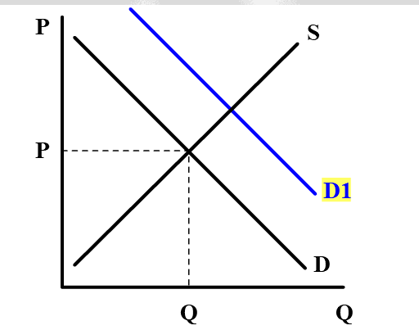

Slide 37
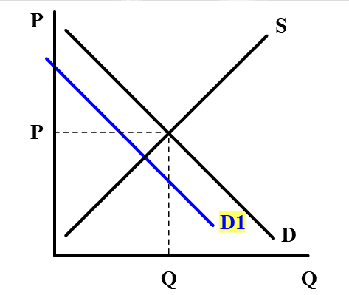

Slide 38
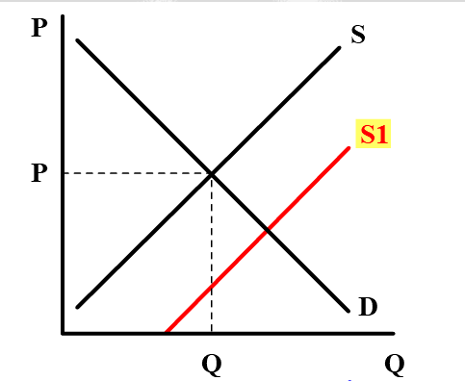

Slide 39
