Slide 1
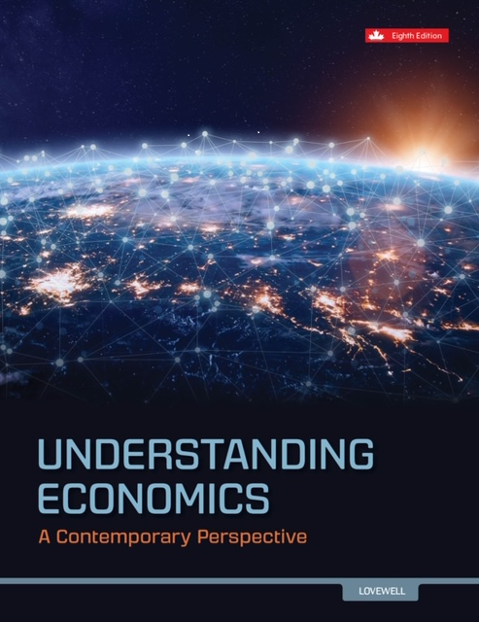

Slide 2
Chapter 1 The Economic Problem
Prepared by Murray Davidson, Centennial College.

Slide 3
Learning Objectives
After this chapter you will be able to:
LO1 describe the economic problem – the problem of having unlimited wants, but limited resources – that underlies the definition of economics
LO2 explain how economists specify economic choice, including the production choices an entire economy faces, as demonstrated by the production possibilities model
LO3 identify the three basic economic questions and how various economic systems answer them

Slide 4
How Economists Think
Economists assume that people customarily engage in rational behaviour.
People are assumed to make choices by logically weighing the personal benefits and costs of available actions. They then select the most attractive option.
Each one of us makes choices by logically weighing the personal benefits and costs of every available action then selects the most attractive option based on our individual wants
They then select the most attractive option.

Slide 5
Purposeful Behaviour
Economists assume that human behaviour reflects “rational self-interest”
Individuals look for and pursue opportunities to increase their utilities or satisfaction, pleasure or happiness
Because individuals consider costs and benefits their decisions are purposeful or rational rather than random or chaotic
Having rational self-interest does not mean that we are completely selfish; often we derive satisfaction when we help others
Rationality does not mean that we can’t make wrong decisions; we do make wrong decisions, in part, because we don’t have all the information we need

Slide 6
Marginal Analysis
Every time we make a rational choice we weigh the marginal benefit and marginal cost of the action
Marginal means additional or extra
We will choose to do something if the marginal benefit is greater than the marginal cost because that will help us maximize satisfaction
On the other hand, if a person says, “That’s not worth it,” then in “economic-speak,” they are saying that the marginal cost is greater than the marginal benefit

Slide 7
Economic Way of Thinking
Scarcity & choices | Purposeful Behaviour | Marginal Analysis
Economist's View | Rational Self-Interest
If there were no scarcity, there would be no need to economize so there would be no need to make choices | Economists assume that people are rational, weighing costs & benefits of alternatives | Marginal means additional or extra. We will choose to do something if the marginal benefit is greater than the marginal cost
 | Doesn’t mean the decision is always correct | Pleasure, happiness, self-satisfaction

Slide 8
e.g. Find a Wallet with $1000
Options:
Return wallet to the owner
Return wallet to the owner without the $
Keep the $ and leave the wallet where it was found
Leave the wallet and $ where it was found
Which choice is rational depends on the individual decision maker

Slide 9
The Economic Problem
Economists deal with the economic problem, which presumes:
Economic agents must continually make choices.
Their wants are unlimited.
They face a limited supply of economic resources.

Slide 10
Economic Problem
Unlimited needs and wants but finite (limited) economic resources
We face scarcity in economic resources and can only have limited goods and services
http://yadayadayadaecon.com/clip/47/ (Seinfeld)
https://www.youtube.com/watch?v=-0od0t45oeY (scarcity and choice)

Slide 11
Economic Resources
Economic resources include:
natural resources, or nature’s contribution to production
capital resources, or the processed materials, equipment, and buildings used in production
human resources, which include both labour and entrepreneurship

Slide 12
Economics Defined
Economics: the study of how to distribute scarce resources to make choices
Economics is divided into two branches:
Microeconomics focuses on how consumers decide on the quantity of a product to consume or the quantity of the product businesses will produce.
Macroeconomics focuses on the production within a country and opportunities of trade with other countries.

Slide 13
Microeconomics
The branch of economics that analyzes the market behavior of individual consumers and firms in an attempt to understand the decision-making process of firms and households.
It is concerned with the interaction between individual buyers and sellers and the factors that influence the choices made by buyers and sellers.
In particular, microeconomics focuses on patterns of supply and demand and the determination of price and output in individual markets (e.g. coffee industry).
http://www.investopedia.com/terms/m/microeconomics.asp?utm_source=term-of-the-day&utm_medium=email&utm_campaign=TOD-5/31/2015 (use in Chapter 2)

Slide 14
Macroeconomics
Macroeconomics
The field of economics that studies the behavior of the aggregate (whole) economy.
Macroeconomics examines economy-wide phenomena such as changes in unemployment, national income, rate of growth, gross domestic product, inflation and price levels. http://www.investopedia.com/terms/m/macroeconomics.asp
The factors that are studied by macro and micro will often influence each other, such as the current level of unemployment in the economy as a whole will affect the supply of workers which an oil company can hire from, for example.

Slide 15
Economic Models
Economic models: simplify economic reality
Variables: factors that have measurable values
show how dependent variables: the variable in a causal relationship that is affected by another variable are affected by independent variables: the variable in a causal relationship that causes change in another variable

Slide 16
Economic Models
Relationships:
include inverse: a change in the independent variable causes a change in the opposite direction of the dependent variable and/or direct relationships: a change in the independent variable causes a change in the same direction of the dependent variable
are classified as part of either positive economics or normative economics

Slide 17
Economic Models
Assumptions:
Ceteris paribus: the assumption that all other things remain the same

Slide 18
Economic Models
Positive economics: the study of economic facts and why the economy operates as it does
Normative economics: the study of how the economy ought to operate

Slide 19
Positive and Normative Economics
A positive statement is provable- “Canadians bought five million high definition televisions last year”.
A normative statement is opinion-based- “We should reduce taxes”.

Slide 20
1.1 Practice Question
Analyze the following statement: “The economic welfare of a country’s citizen falls if there is a reduction in the quantity of the country’s economic resources.”
The statement refers to two variables. What are they?
Which variable is independent and which is dependent?
Is the relationship between these variables direct or inverse?
Is the statement positive or normative?
How is the statement related to the economic problem?

Slide 21
Answer to Practice Question 1.1
a. The two variables are (i) the economic welfare of the country's citizens, and (ii) the quantity of the country's economic resources.
b. The quantity of the country's economic resources is the independent variable (since it is the cause) and the economic welfare of the country's citizens is the dependent variable (since it is the effect).
c. The relationship is direct, because a movement in the independent variable's value leads to a movement of the dependent variable's value in the same direction.
d. The statement is positive, since it is a description of reality that does not depend on value judgments.
e. For the country described in the statement, the economic problem of scarcity has become more severe.

Slide 22
1.2 Economic Choice
Economists assume that economic decision-makers maximize their own utility: the satisfaction gained from any action
Self-interest motive: the assumption that people act to maximize their own welfare

Slide 23
Opportunity Cost
The utility that could have been gained by choosing an action’s best alternative

Slide 24
Opportunity Cost
We must decide what we will have to forgo (give up)
Making choices is difficult because it means giving up something we want
There is a cost to every choice we make—”opportunity cost”
“There’s no such thing as a free lunch”

Slide 25
Opportunity Cost
The opportunity cost of taking an action is the value of the best alternative forgone (given up) due to the action taken
What did you give up to be in this class?
What would you be doing if you weren’t in the class right now?
It’s important to note that everyone’s opportunity cost will be different

Slide 26
Real World Examples
Pizza or wings?
Imagine a two-good economy, which produces pizza and wings.
Now make the further assumption that this economy has only two people.
One person is good at making pizzas and the other is better at making wings.
When this is the case, the potential gains from trade are clear.
Each person will specialize in what he or she is good at producing and trade in order to acquire some of the other good being produced.
There are two people in our economy: Debra Winger and Mike Piazza.
If Debra devotes all of her work time to making pizzas, she can produce 60 pizzas. I
f she does not spend any time on pizzas, she can make 120 wings.
On the other hand, Mike can spend all his time on pizzas and produce 24 pizzas or all his time on wings and produce 72 wings.
 | pizzas | wings
Debra Winger | 60 0 | 0 120
Mike Piazza | 24 0 | 0 72

Slide 27
Activity—Step 1
How many of you never seem to have enough time to do all the things you want to do?
Imagine you find yourself with an hour of free time tonight that you did not expect to have
What might you like to do with this hour of free time?

Slide 28
Activity—Step 2
Why can’t you do all of the things listed?
Write down four or five activities you would most like to do with one hour of free time

Slide 29
Opportunity Cost
The idea of opportunity cost involves more than money.
The person who spends $2 to buy a pizza slice at the fast-food restaurant faces an opportunity cost equal to the utility that could have been gained by eating a low-calorie veggie burger instead
If the person chooses the veggie burger, the opportunity cost is the sacrificed pleasure of eating a slice of pizza
For a weight-conscious consumer, the utility gained from eating the veggie burger probably outweighs the pleasure from eating the slice of pizza
The veggie burger’s opportunity cost is lower than the opportunity cost of the pizza slice (even though both have the same monetary price), making the veggie burger the preferred choice for this individual

Slide 30
The Production Possibilities Model
The production possibilities model is based on three assumptions:
an economy makes only two products
resources and technology are fixed
all resources are employed to their fullest capacity

Slide 31
The Production Possibilities Schedule and Curve (a)
The production possibilities schedule: a table that shows the possible output combinations for an economy
The production possibilities curve: shows a range of possible output combinations for an economy.
It highlights the scarcity of resources.
It has a concave shape (bows out), which reflects the law of increasing opportunity costs: the concept that as more of one item is produced by an economy, the opportunity cost of additional units of that product rises

Slide 32
The Production Possibilities Curve (b) FIGURE 1.1
Production Possibilities Curve
Production Possibilities Schedule
Hamburgers Computers point
on graph
a
1000
b
unattainable
900
f
Hamburgers
c
600
1000 0 a
900 1 b
600 2 c
0 3 d
e
inefficient
d
0 1 2 3
Computers

Slide 33
The Law of Increasing Opportunity Costs FIGURE 1.2
Production Possibilities Curve
Production Possibilities Schedule
Hamburgers Opportunity Computers point
Cost of on graph
Computers
a
As the quantity
of computers
rises, so does their
opportunity cost.
1000
b
900
1000 0 a
Hamburgers
600
c
100
900 1 b
300
600 2 c
600
0 3 d
d
0 1 2 3
Computers

Slide 34
Economic Growth
Economic growth occurs when:
the production possibilities curve shifts outwards due to more resources or an improvement in technology
the economy moves from a point within the area bounded by the production possibilities curve to the curve itself

Slide 35
Shifts in Production Possibilities FIGURE 1.2
Production Possibilities Curve
1000
With more
computers, the
curve shifts out
in the next
period.
Hamburgers
0 3
Computers

Slide 36
Economic Contraction
Economic contraction occurs when:
the production possibilities curve shifts inward
the economy moves from a point on the production possibilities curve to a point within the area bounded by the curve

Slide 37
The Basic Economic Questions
There are three basic questions any society must answer:
what to produce
how to produce
for whom to produce

Slide 38
Economic Systems
Economic systems: the organization of an economy which represents a country’s distinct set of social customs, political institutions, and economic practices
There are three systems to choose from:
Traditional economies focus on non-economic concerns and have tight social constraints.
Market economies are consumer-centered and innovative but create inequality and instability.
Command economies equalize incomes but often have a lack of freedom.

Slide 39
Market Economy
Market: a set of arrangements between buyers and sellers of a certain item
Product markets: markets in which consumer products are traded
Resource markets: markets in which economic resources are traded

Slide 40
Benefits and Drawbacks of a Market Economy
Benefits:
Consumer sovereignty
innovation
Drawbacks:
Income distribution
Market problems
instability

Slide 41
Benefits and Drawbacks of a Command Economy
Benefits:
Income distribution
Economic growth
Drawbacks:
Planning difficulties
Inefficiencies
Lack of freedom

Slide 42
The Range of Economic Systems (a)
Most countries have Mixed Economies.
Modern mixed economies include both private and public sectors.
Traditional mixed economies combine traditional sectors with private and/or public sectors.

Slide 43
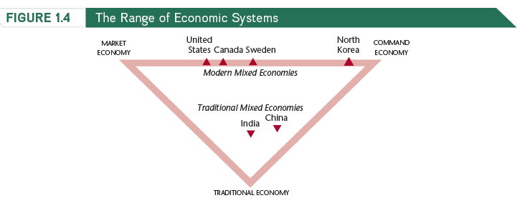
The Range of Economic Systems (b)

Slide 44
China
The contemporary economic transformation of China began in the 1970s with growth-enhancing reforms in its agricultural sector.
In the 1980s, this growth spread to other sectors, thanks to reforms allowing state-owned producers to keep some of their profits.
After 1990, private companies became common, causing a further increase in annual growth.
By the late 2000s, this growth meant that China’s economy was five times larger than in 1978.

Slide 45
India
Reforms during the early 1990s freed private businesses in key sectors of India’s economy.
High growth rates appeared first in services, before being extended to manufacturing.
India’s annual rates of economic growth now average about 8% – just a little less than the 10% rates found in China’s economy.

Slide 46
Economic Goals
There are seven major economic goals:
economic efficiency
income equity
price stability
full employment
viable balance of payments
economic growth
environmental sustainability

Slide 47
Economic Goals
There are seven major economic goals:
economic efficiency: employing scarce resources in a way that derives the highest benefit
income equity: what is fair?
price stability: gov’t. policy-makers try to minimize rate of inflation
full employment: gov’t. tries to minimize involuntary unemployment
viable balance of payments: a summary of all transactions between Canadians and foreigners that involve exchanging Canadian dollars for other currencies
economic growth: helps raise the standard of living of citizens
environmental sustainability: economic activity must be carried out so that the quality of our physical environment can be sustained without significant harm

Slide 48
Complementary and Conflicting Economic Goals
Economic goals may be complementary.
An example is the relationship between full employment and economic growth.
Economic goals may be conflicting.
An example is the relationship between price stability and full employment.

Slide 49
Climate Change
Concerns over climate change illustrate the complexities in accomplishing economic goals.
The mainstream scientific prediction is that, if unchecked, the increase in carbon emissions will cause average global temperatures to rise by between 1.5% and 6% by 2100.
Attempts to reduce emissions worldwide, through the Kyoto Protocol, achieved only limited success.

Slide 50
The Founder of Modern Economics
Adam Smith:
explained how the division of labour increases production
argued that self interest is transformed by the invisible hand of competition so that it creates significant economic benefits
stressed the principle of laissez faire, which means that governments should not intervene in economic activity

Slide 51
Conclusion
Showed how the economic problem is scarcity of resources
Explained the way in which economic choices relate to maximizing utility; the concept of opportunity cost.
Described mixed, command, traditional and market economies.
Identified economic questions – what to produce, how to produce and for whom to produce.

Slide 52
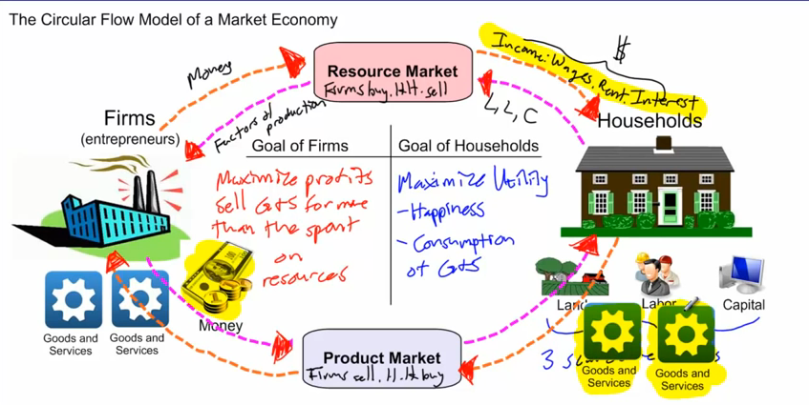
Bonus: Circular Flow Model
http://www.youtube.com/watch?v=_PKH2wtDT3E
http://www.stlouisfed.org/education_resources/economic-lowdown-video-companion-series/episode-6-circular-flow/

