Slide 1
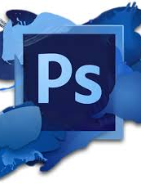
PhotoShop

Slide 2
PANELS

Slide 3
.psd vs .jpeg and png file types
.psd – photoshop document. Will keep your layers.
.jpeg – common file format for digital photos. When used in Photoshop it flattens the image to convert it into a picture. (Must use .jpeg or .png files to upload to your weebly page.)
Any of your assignments that need to go on your weebly pages must be saved twice:
.psd - for me to be able to mark your layers in Photoshop.
.jpeg or png - for your weebly page. May have to change the size of your file in order to upload to weebly.

Slide 4
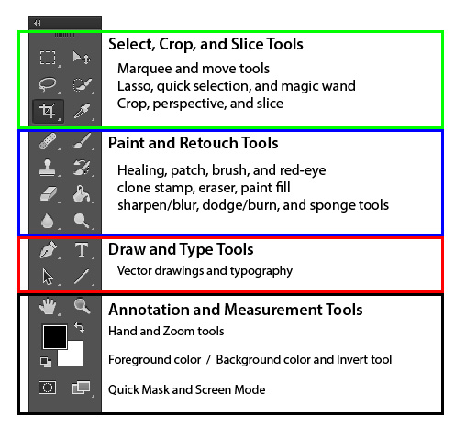
PhotoShop Toolbar

Slide 5
Using the following site or the internet, briefly describe the function of each tool in Photoshop toolbar: http://photoshop-how-to.blogspot.ca/2011/06/tools-and-their-uses.html
Select Crop and Slice Tools
⬅ Move Tool - move or resize selection
⬅ Selection Tool – make selections
⬅ Lasso – freehand selection

Slide 6
Paint and Retouch Tools

Slide 7
Draw and Type Tools

Slide 8
Annotation and Measurement Tools

Slide 9
Shortcuts/Things to know
Tiling – organizing windows on a screen (Window – Arrange – Tile)
Hold spacebar for hand tool (to pan the canvas)
Eye icon – hiding a layer (it does not delete)
Ctrl D – deselect the travelling ants
Ctrl Z – undo (you could also use the history panel)
Duplicating a layer (ALT – click – hold and drag)
Hold down the brackets to change the size of your brush

Slide 10
renaming a layer - double click on layer name
setting the resolution - 72 vs 300 dpi (300 better quality)
rearranging layers – drag and drop
Crop tool – allows you to cut a picture down to the size you want
angling photos – place cursor outside the image until you get the two arrows
adding images + photos in Photoshop:
save the image and then file-Place Embedded
copy and paste
open the image as a separate document and move it
opacity - slider that controls how visible a layer is

Slide 11
gradients -blends two colors together. Can be used on a layer or text.
blending modes for layers (layers panel)- controls how pixels in the image are affected by a painting or editing tool.
adding text – use the text tool
adding a layer style:
click on fx. on the layers panel or double click next to the layer name to open the layer style window. YOU MUST CLICK ON THE STYLE NAME TO OPEN THE OPTIONS WINDOW. IF YOU CLICK ON THE CHECK MARK ✓ YOU WILL NOT GET THE OPTIONS FOR THAT STYLE.

Slide 12
Applying a Layer Style
https://www.youtube.com/watch?v=IUIiXzjILew.

Slide 13
Borders
Adding a border around the entire document
Gradient Option:
Create a new empty layer (layer panel bottom right)
Drag it to the very top of your layers
Select - Select all
Select - Modify - Border (choose pixel width)
Edit - fill - contents - choose colour
Solid Colour:
Select background layer – unlock
Double click to open layer style
Select stroke – change size and colour of your choice
You may have to change the size of your other layers

Slide 14
Adding a border around a specific layer:
Select the layer you want to add a border to
Double click on the layer to open the layer style
Select stroke - change size and colour of your choice
To Copy Layer Style:
Select your layer style
Right mouse click on the fx icon – choose copy Layer Style from the menu
Select target layer – right mouse click – choose paste layer style

