Slide 1

Money Management
What is your money personality?

Slide 2
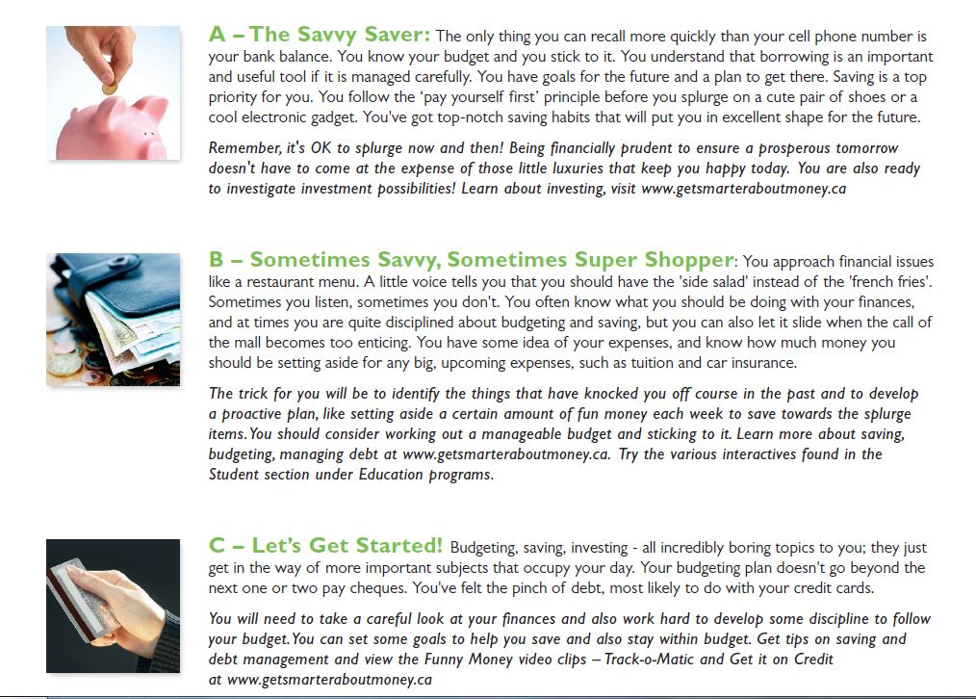

Slide 3
Section 1: Money

Slide 4
The BaraniukBucks™Challenge
If the Bank of Canada would increase interest rates, this would most likely have what effect on inflation?
Speed up inflation
Slow down inflation

Slide 5
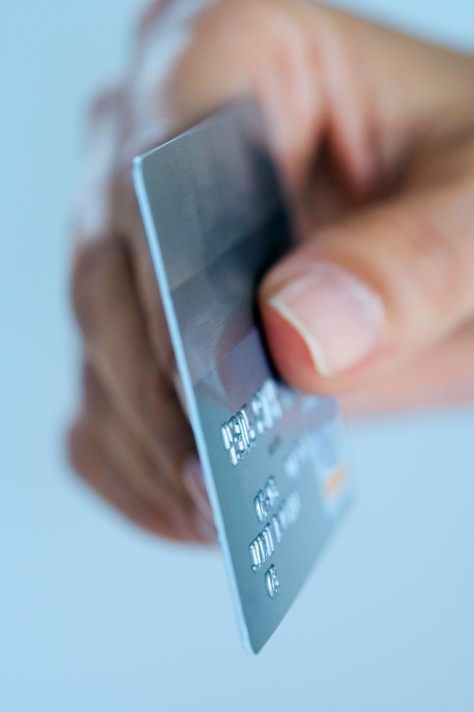
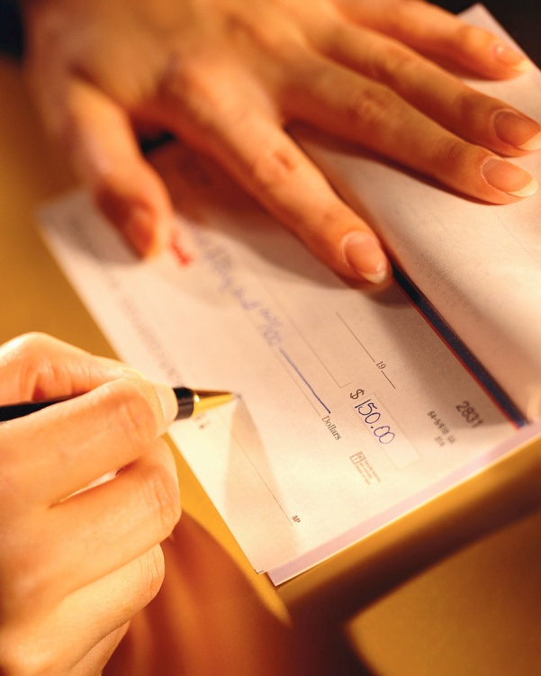
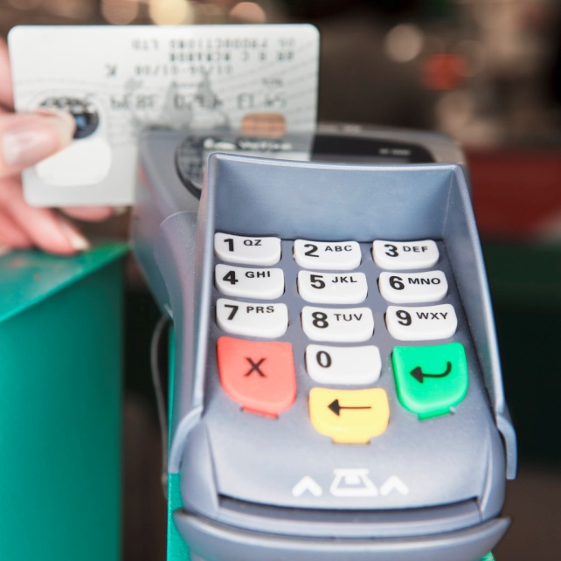
Forms of Money/Exchange
Besides paper money, what do we use as money?
Notes:
Funny Money video for credit card
Interactive tool for cheques

Slide 6
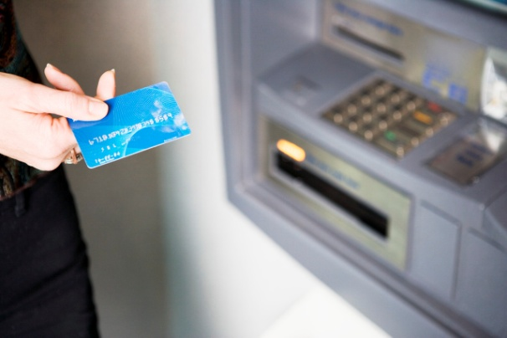
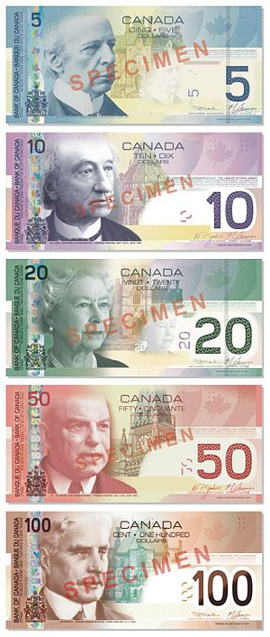

Advantages/Disadvantages?
Currency/Cash
Cheques
Debit Cards

Slide 7
Currency/Cash
DISADVANTAGES:
  LIMITED SHOPPING OPPORTUNITIES
  LIMITED RECORD KEEPING
  SECURITY CONCERNS
Advantages:
  Spending Within Your Means
  Keeping Debt at Bay
  Protecting Your Identity
https://pocketsense.com/advantages-disadvantages-paying-cash-6569741.html

Slide 8
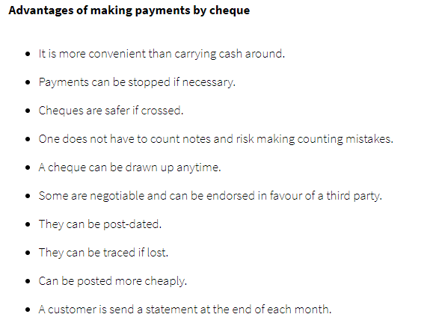
Cheques

Slide 9
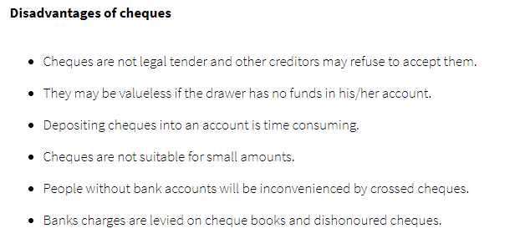
Cheques (cont’d)

Slide 10
Debit Cards (advantages)
Easy to obtain. Once you open an account most institutions will issue you a debit card upon request.
Convenience. Purchases can be made using a chip-enabled terminal or by swiping the card rather than filling out a paper check.
Safety. You don't have to carry cash or a checkbook.
Readily accepted. When out of town (or out of the country), debit cards are usually widely accepted (make sure to tell your financial institution you’re leaving your city; to not have an interruption in service).

Slide 11
Debit Cards (disadvantages)
No grace period. Unlike a credit card, a debit card uses funds directly from your checking account. A credit card allows you to borrow funds on credit, leaving disposable cash in your account.
Check book balancing. Balancing your account may be difficult unless you record every debit card transaction.
Less protection. Most financial institutions will try and protect their customer from debit card fraud. However, a customer could potentially be liable for up to $500 on fraudulent debit card transactions compared with only $0 on credit cards.
Fees. Using your debit card for ATM transactions may be costly if the ATM is not affiliated with your institution.

Slide 12

Alternative Forms of Money?

Slide 13
Cryptocurrency (advantages)
Easy to Use.
Decentralization.
You Can Use Crypto Internationally.
Low Operation Cost.
You Can Do Unlimited Transactions.
Fast Transactions.
Transparency.
Anonymity.
Highly Secured.
No Inflation.
Peer-to-Peer Cryptocurrency Network.

Slide 14
Cryptocurrency (disadvantages)
Lack of Knowledge.
Strong Volatility.
Large Risks of Investing in Cryptocurrency.
Not Accepted Widely.
Not Able to Reverse the Payment.
Storing of Cryptocurrencies.
https://ccoingossip.com/advantages-and-disadvantages-of-cryptocurrency/

Slide 15
“Forms of Money” Infographic Assignment

Slide 16

What is wealth?
To achieve the goals you set yourself for the future, you need to build wealth. You need to learn how to:
1) earn money
2) budget to save
3) save and invest
4) control debt

Slide 17
Building Wealth
Building Wealth

Slide 18
Step 1: Earning Money
What do you want to be “when you grow up”?
Understanding the job market/outlook
Your resume
Filling out application forms
Reasons to work besides money?
Notes:
Myblueprint.net
Occupation research assignment

Slide 19
Earning Money
There are many different ways you can be paid when you are an employee.
*hourly wage
*salary
*piecework/commission
*contracts
The money you earn is known as remuneration.
Notes:
Teens are an attractive market for marketers because they have a lot of discretionary income
Discuss terms like trade-off and opportunity cost—how do they related to making financial choices?

Slide 20
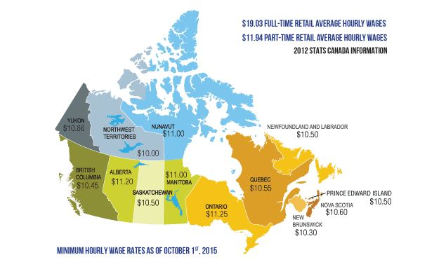

Slide 21
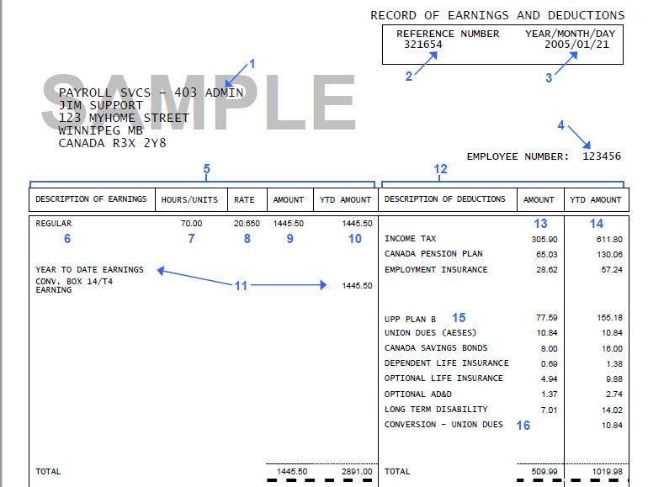

Gross Pay: money earned for this pay period BEFORE deductions.
Net Pay: “take home” pay AFTER deductions.

Slide 22

So you’ve got a job…now what?

Slide 23

Section 2: Budgeting & Saving

Slide 24

Needs vs. Wants
What is the difference between a need and a want?
Notes:
A need is something you have to have; a want is something you would like to have
As consumers, we are bombarded with advertising that is designed to convince consumers that wants are needs—is this unethical?

Slide 25

Resources Limit Choices
Because your financial resources are limited, you need to make choices on what you spend your money on.
The amount of money you have to spend after all of your needs are met is called discretionary income.
Notes:
Teens are an attractive market for marketers because they have a lot of discretionary income
Discuss terms like trade-off and opportunity cost—how do they related to making financial choices?

Slide 26
Where does all your money go?
INCOME
Income refers to money that you have earned, won or received from a variety of sources. This is money coming in.
EXPENSES
Expenses refer to money that you must pay out for things you want/need.
If your monthly income is greater than your monthly expenses, the result is a net income.
If your monthly expenses are greater than your monthly income, the result is a net loss.
Notes:
Prepare a personal Income and Expense Statement (Excel)

Slide 27
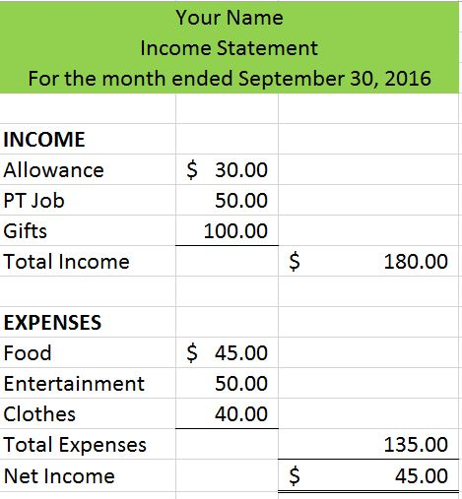
Net Income =
Total Income – Total Expenses

Slide 28
Figuring out your net worth
ASSETS
Assets are money and other items of value that you own.
LIABILITIES
Liabilities are debts that you owe.
The difference between your assets (what you own) and your liabilities (what you owe) is called your net worth.
Notes:
Prepare a personal Balance Sheet (Excel)
Discuss assets that appreciate and depreciate

Slide 29
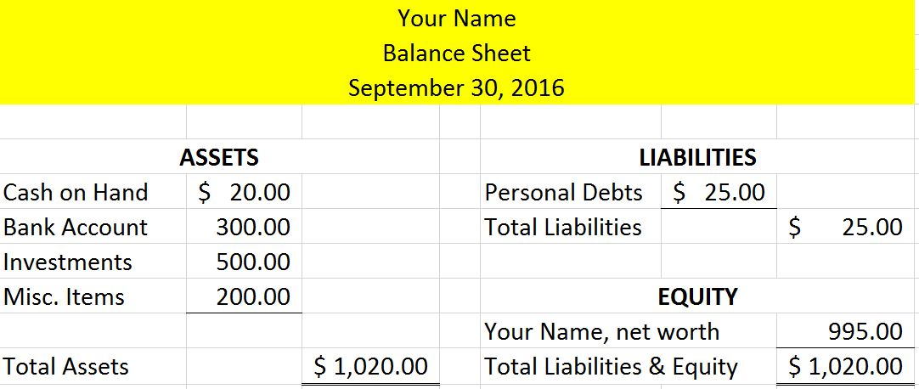
Net Worth =
Total Assets – Total Liabilities

Slide 30
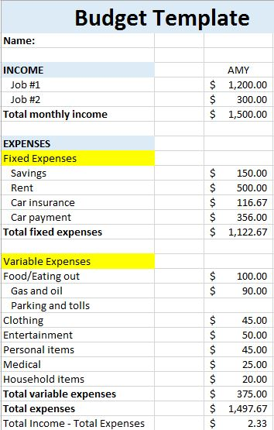
A budget is a tool used to help you manage your money so you do not get into financial trouble.
There are two main sections: Income &
Expenses
Fixed Expenses-expenses that generally stay the same from month to month
Variable Expenses-expenses that can vary from month to month

Slide 31
Budgeting Tips
Set short term and long term financial goals
Keep track of your spending (keep every receipt, record your expenses, etc.)
Pay yourself first principle—save a set amount every month (automatic withdrawal) *save at least 10% of net income
Set your priorities: (1) needs first, (2) saving, (3) then wants
Maximize your earnings; limit your spending
Track-O-Matic
Latte Factor

Slide 32
Understanding Your Bills
Tax Considerations (PST & GST)
Tipping
  Restaurants (approx. 15%)
  Other services (hairdressers, taxi drivers, estheticians, massage therapists, etc.) (approx. 10%)
Sales
Discounts

Slide 33
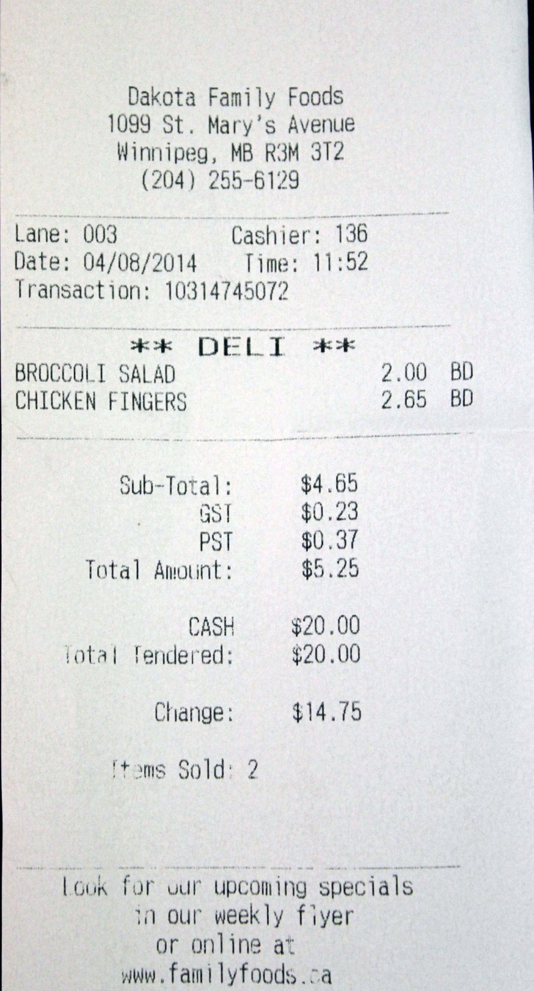
Understanding Your Bills
GST Calculation:
$4.65 * .05 = 0.2325 rounded to $0.23
PST Calculation:
$4.65 * .08 = 0.372 rounded to $0.37

Slide 34
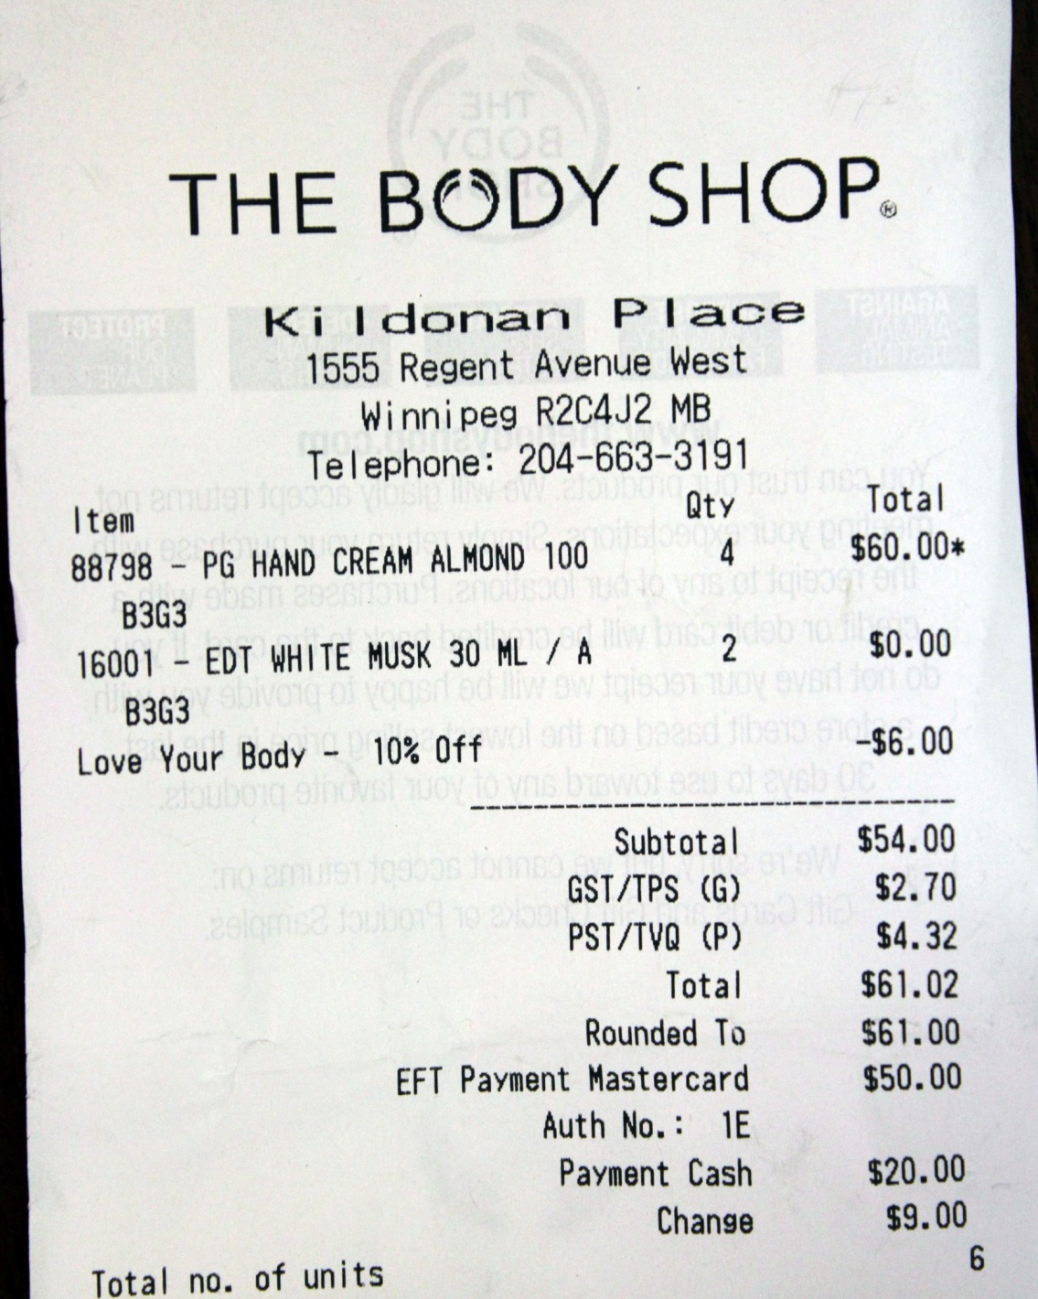
Understanding Your Bills
Sales Discount:
$60.00 * .10 = $6.00
GST Calculation:
$54.00 * .05 = $2.70
PST Calculation:
$54.00 * 0.8 = $4.32
Notice the Rounded to section

Slide 35
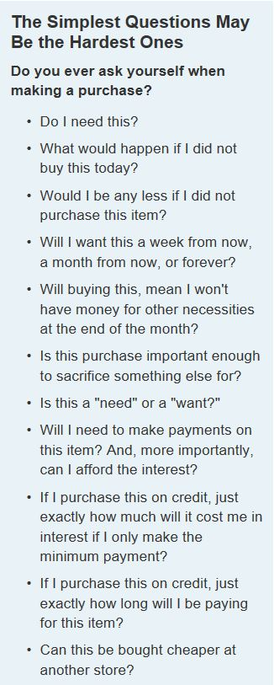

Before You Buy…
Source: Needs vs Wants 101 by Jerilee Wei
Notes:
Teens are an attractive market for marketers because they have a lot of discretionary income
Discuss terms like trade-off and opportunity cost—how do they related to making financial choices?

Slide 36
How to be a Smart Consumer
Extreme Couponing/Cheapskates
Family Foods Shopping Challenge
How to Save Money Assignment/Groups

Slide 37
Section 3: Giving Money Away?
Why give money to charities?
Explain how games of chance work—is gambling a good way to “get rich quick”?
    Gambling and the odds
    Gambling addiction

